Slide 1


Turning Grant Data Into Meaningful Outcomes
Notes:
During break before session play Reflections of Eastern Oregon Multi Media Presentation to welcome people while they are entering and to give a sense of where we live, and some of the things we do (music, photography, education, outdoor activities). State that for us this encompasses many descriptions of what it means to be healthy, and that this is what we strive for, not just improved blood pressure and cholesterol labs. This was sponsored by Grande Ronde Hospital and Eastern Oregon University students and staff.

Slide 2



Slide 3
Northeast Oregon Network
We are a 501(c)3 health collaborative serving Union, Wallowa and Baker Counties, a frontier region in Northeast Oregon.
Our mission is to increase access to and quality of integrated health care for all Northeast Oregon residents by identifying system gaps, facilitating community developed solutions, and advocating for heath policy change.

Slide 4
What do we do?
We act as a resource for developing health and wellness
capacity by providing
assessment,
facilitation,
coordination and
implementation
services to local and state wide partners.

Slide 5
What do we do?
In existence since 2004, we have a proven track record of:
locating opportunities for rural health,
convening community groups for evidence based solution development,
obtaining funding,
marshalling political and content expert support,
managing complex projects, and
measuring outcomes and return on investment.

Slide 6
NEON Programs
Pathways Community Hub
Community Health Worker Training Program
Health Systems Planning
Patient Navigation for Access to Health Care
Consulting

Slide 7
Goal of Session:
Build Momentum and Support for your network by translating grant outcome data into meaningful strategic outcomes.

Slide 8
Session Objectives:
1.) Identify sources of existing grant outcome data and tie grant outcomes to network strategic plan goals;
2.) Translate grant outcome data into doable return on investment calculations relevant to the network’s local partners;
3.) Refine network outcome data presentations to meet the interests of various local audiences;
4.) Utilize network outcomes to build momentum and cohesiveness of the network.
Notes:
Emphasize that it is a system development project, not a direct service provision project. The goal is to create health care reform, system change, at the local level, as we have a value that the local level is where reforms can be the most responsive to community needs, and the most impactful and effective.

Slide 9
Dinamica
Where are you from?
What do you Measure?
How do you use it?

Slide 10

Step 1:
A Good Plan……..

Slide 11
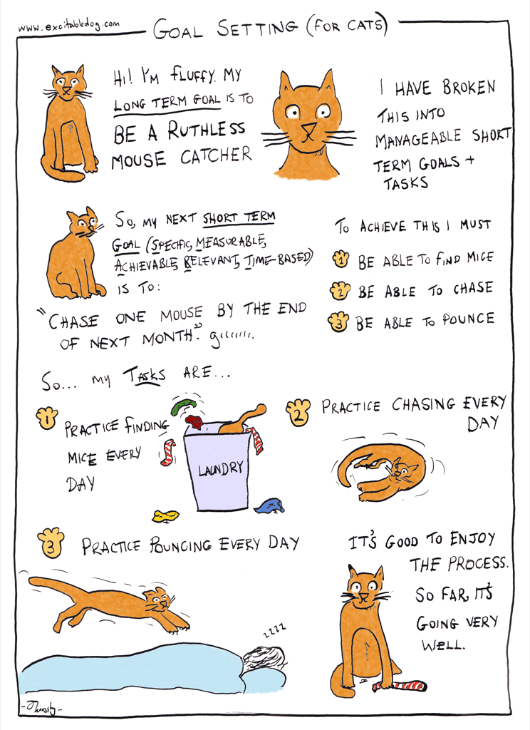

Slide 12
Strategic Plan
Decision Making Process tied to Strategic Plan
Simple and usable tools
Also tied to sustainability strategy
Simple
Clear
Well defined strategic goals and objectives
Short
Notes:
Having a clear simple well defined strategic plan is the start for all evaluation and communication activities. Here is one sample, which is our current NEON strategic plan. First one was 31 pages. Second one was 1 and a half.
The plan should tie to decision making and fiscal structures. Here are two tools that show how we accomplish that.
When choosing a data source, choose one that is core to one of your strategic goals. Can choose any grant that has outputs of some sort, the more specific the data the better. Here we focus on measuring things that meet strategic goals, which in our case relate more to partners than the internal functioning of the network.

Slide 13
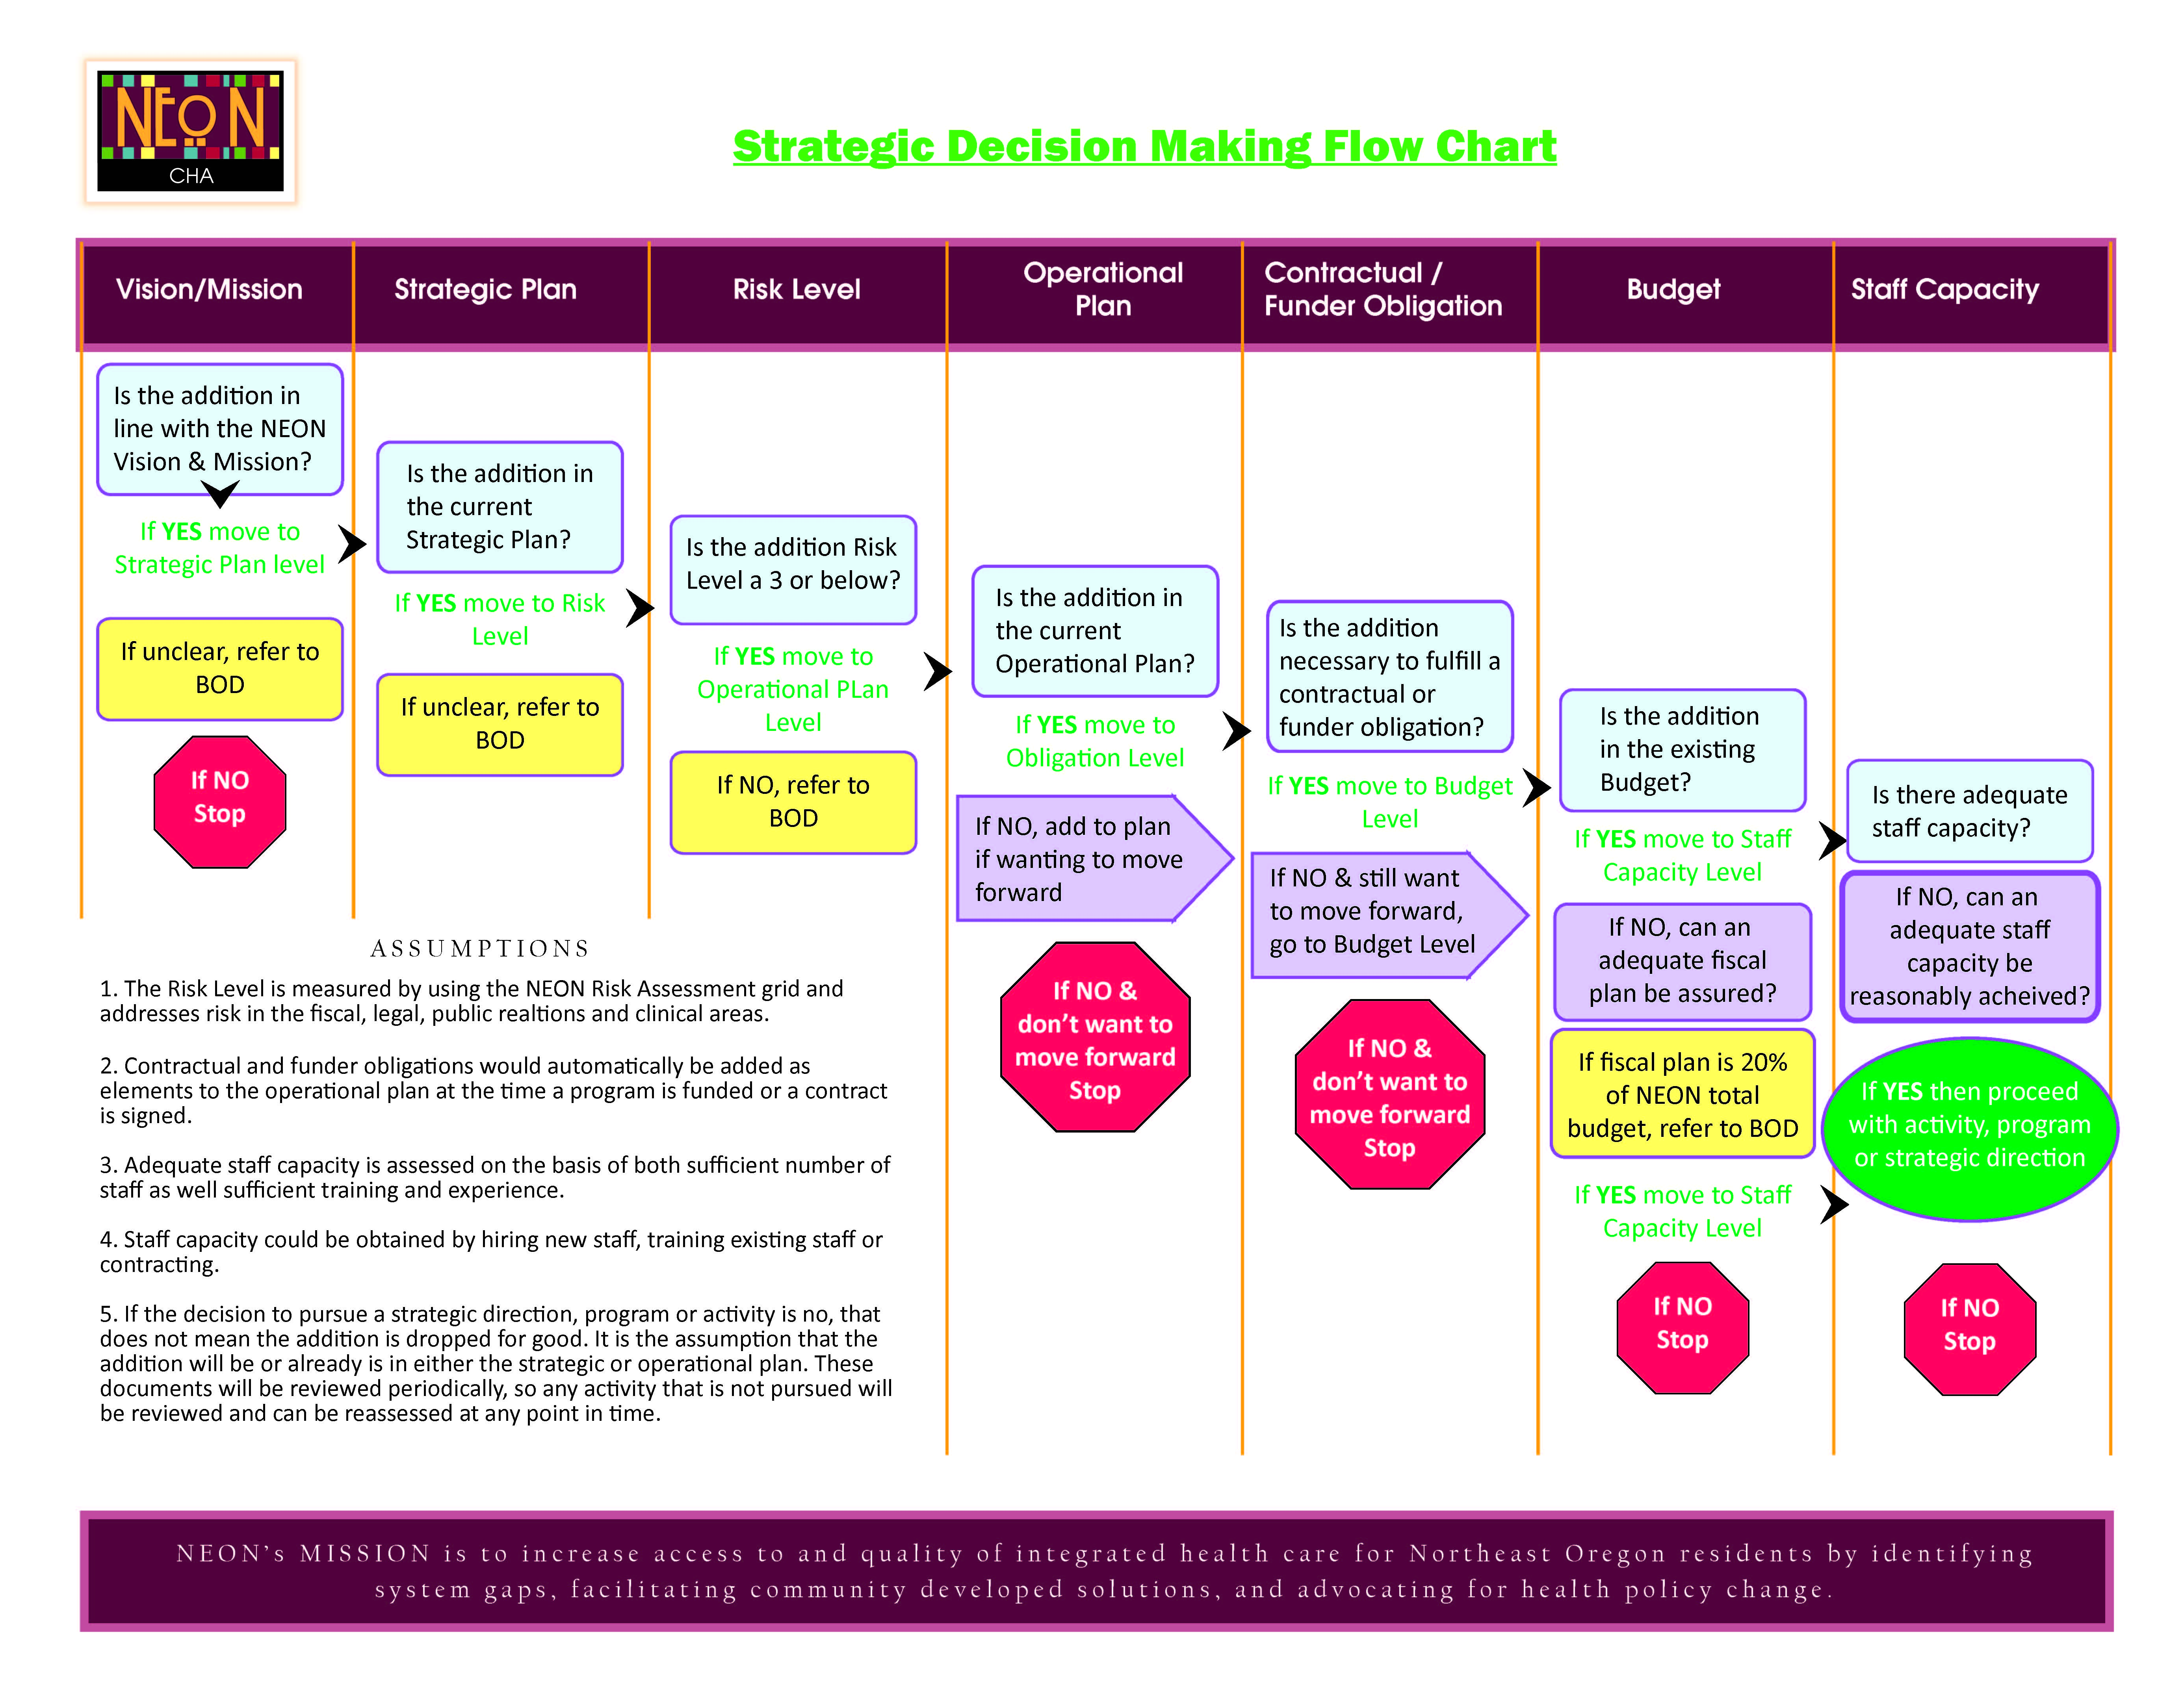
Notes:
We have a strategic decision making tool, using this format, that we fill out whenever we make strategic decision, including what funding to go for. Handout sample.

Slide 14
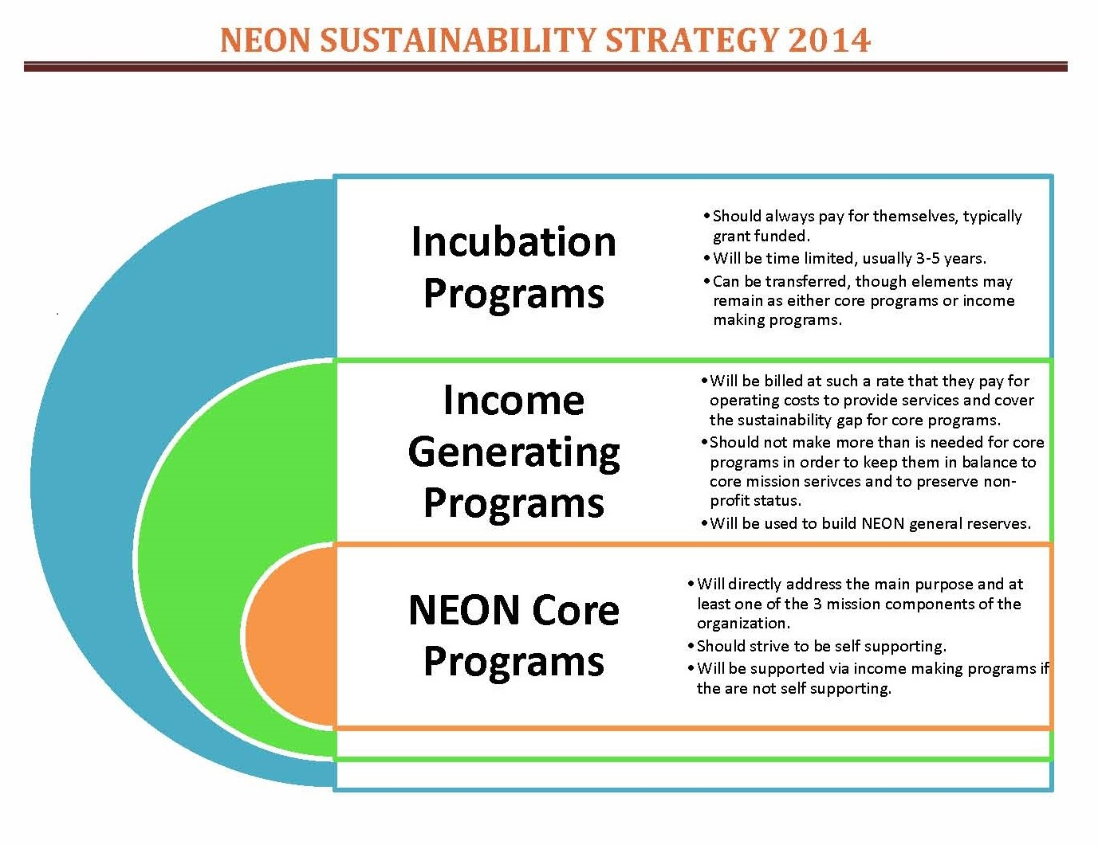
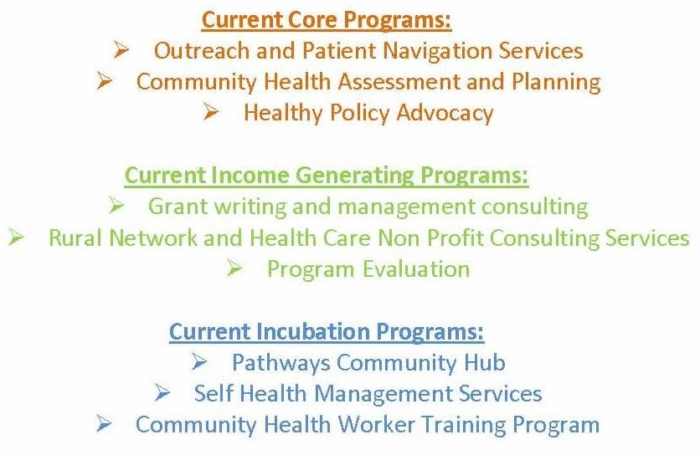
Notes:
Handout sample.

Slide 15






Step 2:
Pick the audience,
Pick the message……….

Slide 16
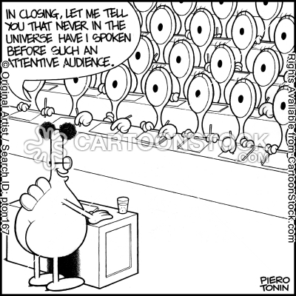

Slide 17
Partner Interests
1.) Identify desired outcome
of message
2.) Identify what partners you need to reach
3.) Identify what their interests are
4.) Determine what data and what type of outcomes will be most meaningful to your target audience
1.) Funding, participation, positive publicity, policy/procedure change.
2.) Local, state
3.) Key informant interviews, reading strategic plans or annual reports
4.) Data analysis can be used to move partners different steps on the collaboration continuum.
Notes:
Most of us as networks have strategic goals about increasing, deepening or strengthening partnerships. One way to look at messaging goals is to determine where you are in terms of stages of collaboration levels, and target moving the relationship up one step. In your handouts you have two different Patient Navigation Proposals; one was the overall proposal written for the project as a whole, and includes all of the data. The second proposal is a specific ask of a local hospital, and includes a pared down version and different ROI information than the overall, more comprehensive one.

Slide 18
Commitment
Resources
Involvement
Collaborating
Cooperating
Coordinating
Networking
Competing
Notes:
Competing: Exchanging some amount of information, but not “proprietary” information; altering activities to meet own needs; sharing resources minimally or with a “hidden agenda”
Networking: Exchanging information for mutual benefit
Coordinating: Networking and altering activities to achieve a common purpose
Cooperating: Coordinating and sharing or pooling resources
Collaborating: Cooperating and enhancing the capacity of another for mutual benefit to achieve a common purpose

Slide 19
Step 3:
Choose Your Measure……….

Slide 20
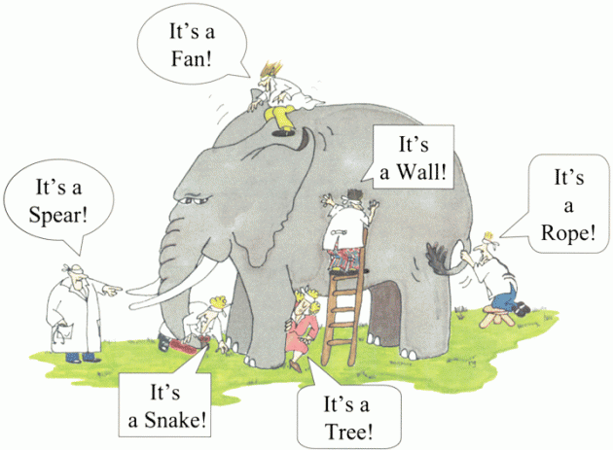

Slide 21
Meaningful Measure Types
Trends of outputs (increasing, decreasing)
Cost of outputs
Economic Impact
Return on Investment
Notes:
Reference handouts here. Note the overall Patient Navigation proposal that has the trend line analysis. Briefly explain that cost of outputs is the most common one we all do, as we need them for developing budgets and managing fiscal needs. It is a measure of efficiency, and does not include effectiveness. Give Economic Impact Handout, and discuss this as a relevant measure to the local business and local government community. Based only on fiscal information, use raconline HRSA Economic Impact Calculator. We will focus now on how to do a ROI measure without an extensive evaluation budget. Return on Investment is typically a measure of both efficiency and effectiveness.

Slide 22

Return on Investment
(Economic Gains-Investment Costs)
Investment Costs
In health care, we have come to the realization that economic gain without corresponding health improvement outcomes is only a short term gain for a small segment. Thus, economic gains also imply improvement in outcomes.

Slide 23
Tools
There are a variety of tools, and different state or federal groups will have tools targeted to different conditions or interventions.
The tool NEON uses is the Center for Health Care Strategies, Inc., as it is not condition specific.
The CHCS tool development was funded by the Robert Wood Johnson Foundation and the Commonwealth Foundation, and is still recommended by them.
RWJF also recommends excel ROI templates.
The Agency for Healthcare Research and Quality has condition specific tools.

Slide 24
Tool Data Input Categories
Intervention
Intervention Name, Disease Specific, Forecast Period
Target Population
Size of eligible, target and intervention populations
Baseline Costs
Baseline cost per person for categories of service (Inpatient, ED, Pharmacy, etc)
Cost Trends
Projected trend for cost of category of service over the life of the project if the intervention did not take place
Utilization Changes
Changes in utilization among the intervention population due to the intervention
Program Costs
Program costs to deliver the intervention, for pre launch, and each year of the program
Sensitivity Range
Sets the percent range for savings, based upon the level of certainty in assumptions
Notes:
Handout results page print outs from the NEON Patient Navigation scenario.

Slide 25
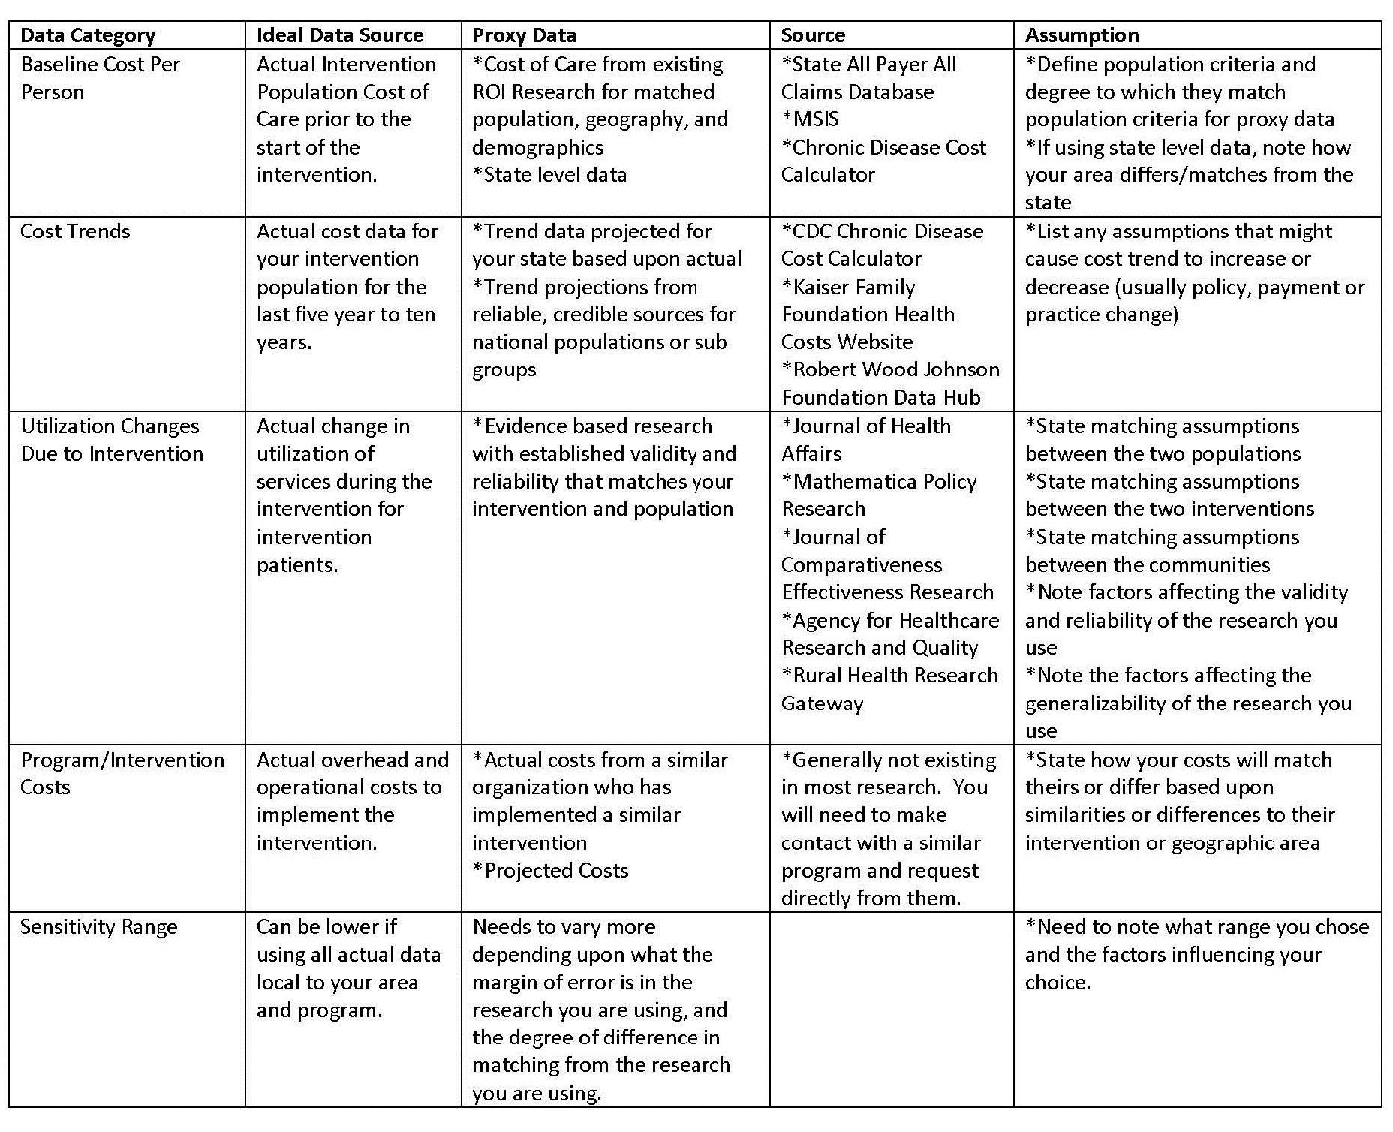
Notes:
Pass out as handout, along with the references listed

Slide 26
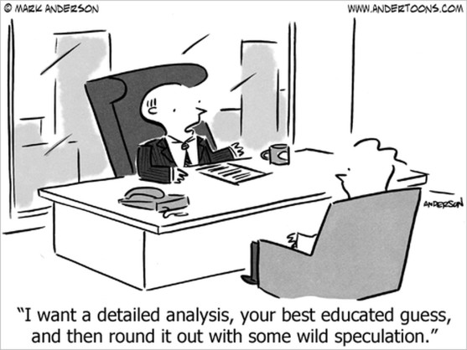
Be very careful to state your assumptions clearly and openly.

Slide 27
Scenario Exercise
Cooperative Learning Scenario
Intervention: Care Coordination and case management provided by trained/certified Community Health Workers
Settings: Doctors Offices, Mental Health Centers, Early Childhood Home Visiting
Population: adults with chronic disease (physical and mental) and early childhood. Generally low income, newly insured, with limited health literacy, social determinant of health needs, and already existing chronic conditions or significant risk factors for such.
Community: Isolated rural communities, with high poverty rates, generally homogenous racially/ethnically as Caucasian, higher incidence of chronic disease, politically conservative and distrustful of government/public services.
Outputs: 12 CHWs serving 500 patients/clients with 1,973 episodes of care (seen at least once in a month)
Time Frame: 6/1/2013 through 4/30/2014
Notes:
Handout scenario

Slide 28
Scenario Exercise Review
What You Want to Use
Anticipated Challenges

Slide 29


Slide 30
More Information
Contact Us
Resources Available Upon Request
Lisa Ladendorff
lladendorff@neonoreogn.org
541-805-5502
www.neonoregon.org
Sample Evaluation Plans
Sample Economic Impact Reports
Brochures about NEON and our consulting services

Slide 31


