Slide 1
Living (through) the Theory of Change
EVALYTICS LLC
Gwen Martin, Ph.D.

Slide 2
What is Theory of Change?
Evalytics LLC
WHAT & HOW your organization will accomplish what it believes is needed to be successful.

Slide 3
5 Key Elements of Theory of Change (ToC)
Evalytics LLC
WHAT = Results, Outcomes
WHO = Target population, beneficiary
HOW = Strategies, activities, actions, partners
WHERE = Context
WHY = Reasons, assumptions

Slide 4
Why Bother?
Evalytics LLC
Good for you.
Many funders require.
Demands breadth & depth of thinking.
Provides evidence of what does/does not work.
Makes the organization stronger.

Slide 5
How different than a Logic Model?
Evalytics LLC
Not programmatic.
Requires greater substantive knowledge of what is required to accomplish results.
Strategy focus.
Community focus.

Slide 6
Learning Strategy
Evalytics LLC
Simple to Complex
Try it on something you know intimately
Ask questions
Revise, refine, measure

Slide 7
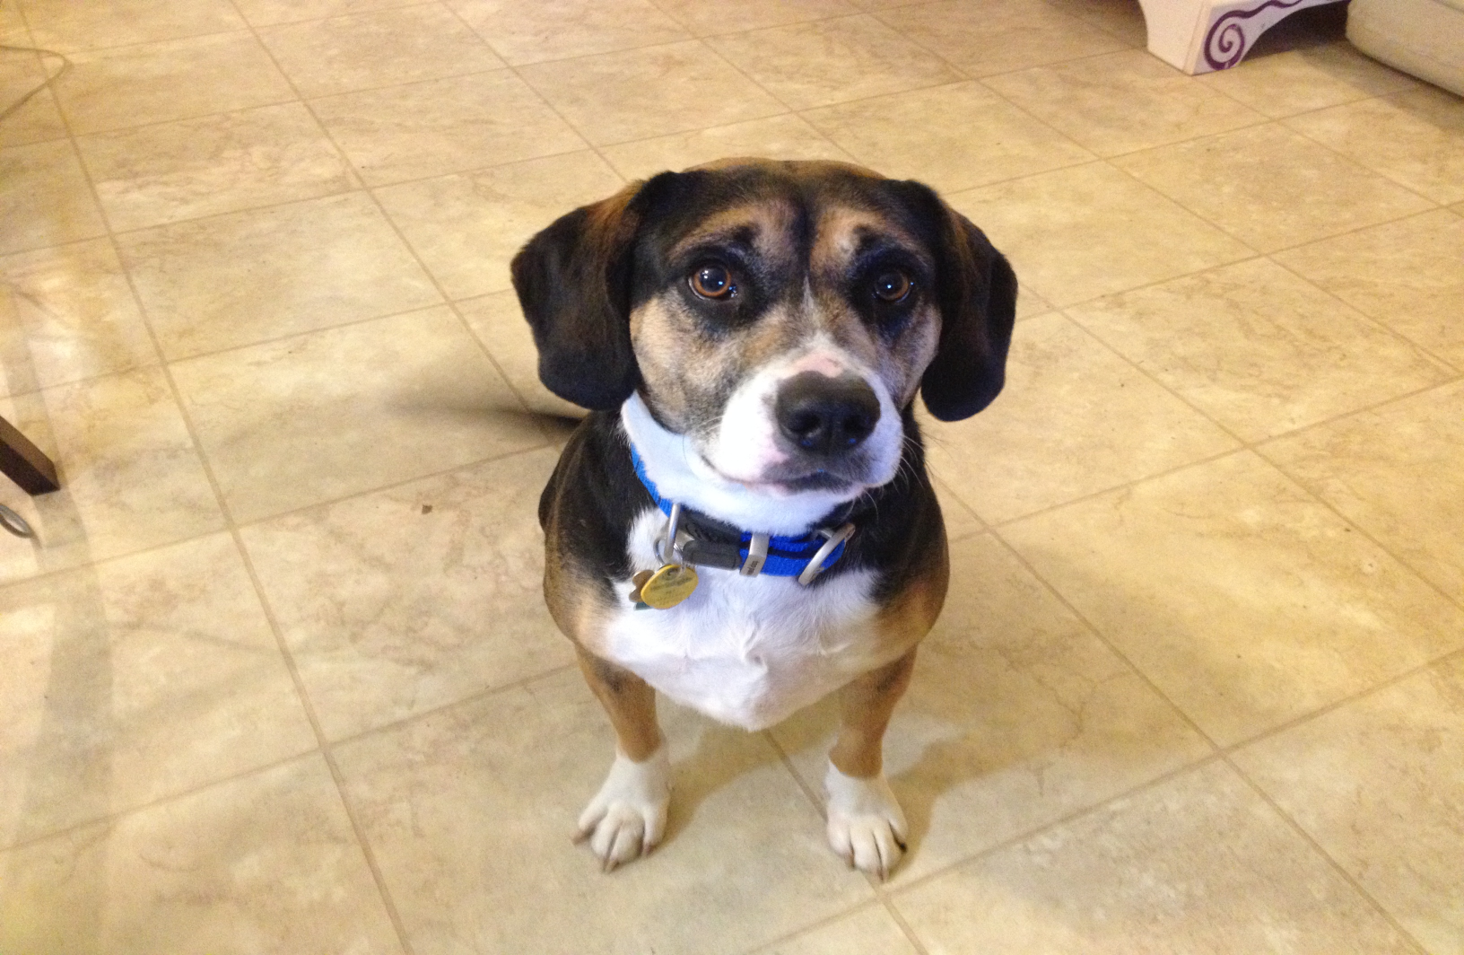
Illustrative Example
Evalytics LLC

Slide 8
August ToC
Evalytics LLC
WHAT? Not aggressive
WHO? August & all other dogs benefit; people benefit
HOW? Health, training, specialists, consistency, behavioral rewards
WHERE? When around other dogs; on walks; at home with dogs & cats
WHY? It’s possible; worthwhile; safety is important; resources available
Questions:
Is the RESULT (WHAT) clear and actually possible?
What am I willing to do? How much time am I willing to devote to this?
What back-up strategies are possible?
Are there alternative solutions?
What happens if I fail?

Slide 9
Evalytics LLC
Check health
Interview trainers
Purchase training gear,
crate, bed
Develop exercise and
practice regimen
DO IT!
Resources:
Veterinarian
Trainers
Time, $$, Patience
Short-Term Outcomes
Follows commands
Walks on leash 15 minutes without incident
Intermediate Outcomes
Not aggressive when sees other dogs 90% of the time
Lives harmoniously with dogs & cats 90% of the time
August Theory of Change

Slide 10
What would you add/delete?
Evalytics LLC

Slide 11
Theory of Change Examples thank you, Bill Moore
Evalytics LLC

Slide 12
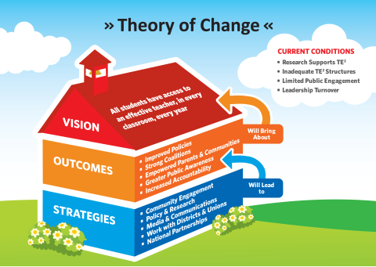
Communities for Teaching Excellence

Slide 13
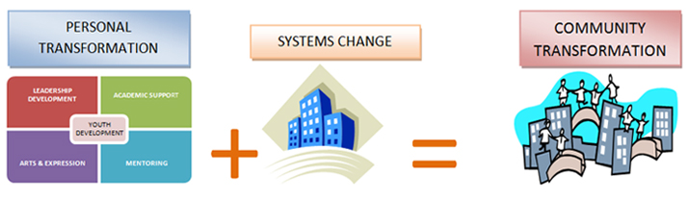
Legacy LA
Empowers youth to become leaders in their
lives and their communities

Slide 14
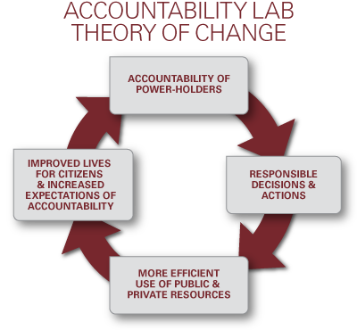
Accountability Lab
Notes:
The Lab supports the accountability of power-holders as this leads to more
responsible decisions and actions. The result, in turn, is more efficient use of
resources and improved lives for citizens.

Slide 15
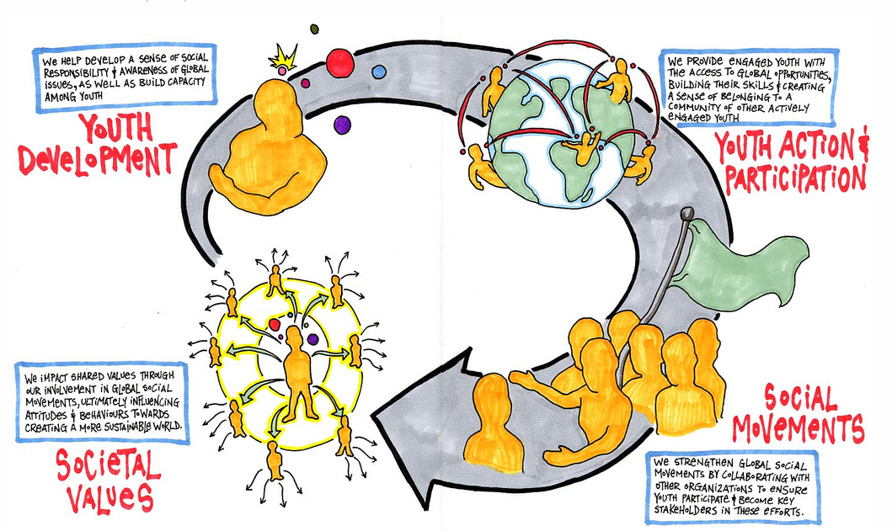
TIG Theory of Change 2010

Slide 17
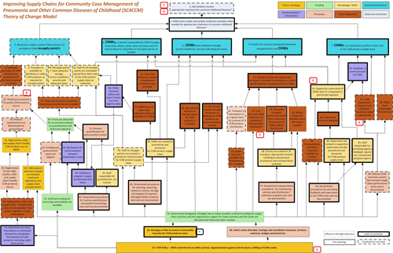
Improving Supply Chains for Community Care Management of Chronic Diseases

Slide 18
REACH Foundation’s Rural Health Initiative (RHI)
Evalytics LLC
Grantees: 3 rural/semi-rural areas in Missouri and Kansas
Broad, inclusive, community-wide effort to use innovation to make significant impact on access to and quality of health care for the underserved.

Slide 19
Rural Health Initiative
Evalytics LLC
The overarching goal for the Rural Health Initiative (RHI) is to create a new way of investing in rural counties that promotes lasting change, ultimately impacting health indicators by increasing access to healthcare and reducing inequities for the unserved and underserved.

Slide 20
RHI Draft Theory of Change; Feb. 2013
Foundational Capacity
Community Core Team
Backbone Organization
Common Agenda/ Shared Vision; Community Agenda
Shared Measurement System
Continuous Communication
Reflection/
Evaluation
Early Outcomes
Intermediate Outcomes
Long Term Outcomes
Strengthened Individual Skills
Consistent Tangible Progress
Toward Goals
Mutually-Reinforcing
Activities among
participants
More effective Community
Organizations and Institutions
Better Resource Utilization by
The Community
Increased Access
Reduced Health
Disparities
Locally-Defined and Selected Intervention(s)
Community Engagement
Larger Stakeholder Group
Diverse Inclusive Citizen Participation
Expanded Leadership Base
Reflection/
Evaluation
Flexible Supports Throughout All Stages of the Theory of Change Process:
Technical Assistance, Site Level Facilitation, Network Weaving,
Local Data/Trends, Evaluation, & Funding
Blue Font= Collective Impact conditions that support change (Kania and Kramer, 2011)
Green font = Capacity Building outcomes that can be used to monitor change (Aspen Institute, 1996)

Slide 21
RHI Framework in the 3 Counties
Evalytics LLC
Innovation
Collective impact
Network weaving
Capacity building

Slide 22
REACH Foundation’s Theory of Change for this initiative
Evalytics LLC
Did it work for REACH?
Did it work for the counties (grantees)?
How might it have been differently constructed?
What was learned as this ToC was implemented?

Slide 23
Value of a Theory of Change
Evalytics LLC
Think about what you are trying to achieve and what is required to get there.
See relationships between resources and activities now and across time.
Share your vision with community members, current/potential funders, etc.
Identify where changes may be needed over time.
Identify what you want to evaluate.

Slide 24
Theory of Change Process
Evalytics LLC
Identify the problems (barriers) that are hindering access, keeping citizens from improving their health, or are creating disparities in health.
Engage your network and community in dialogue to refine thinking and surface new ideas.
Identify your goals (impact).
Identify the changes in capacity, community, personal behavior, policy, etc that will need to occur in order for the goals to be achieved (outcomes).
Seek out strategies that have been shown to bring about the outcomes.

Slide 25
Allen County
Evalytics LLC
Brought new and valuable partners to the table
Leaders learned first-hand about underserved through programming
Extended to county-wide planning

Slide 26
Cass County
Evalytics LLC
Maintained a committed core group
Used ACA as vehicle to engage others
Stepped back, looked for organizational home

Slide 27
Lafayette County
Evalytics LLC
Built outreach effort and folded in need for ACA navigators
Opened a clinic to provide direct services
Obtained FQHC status
Continued outreach efforts

Slide 28
Questions?
Evalytics LLC

