Slide 1
The Critical Access Hospital Network’s Rural Health Information Technology Project
Sue Deitz, MPH

Slide 2
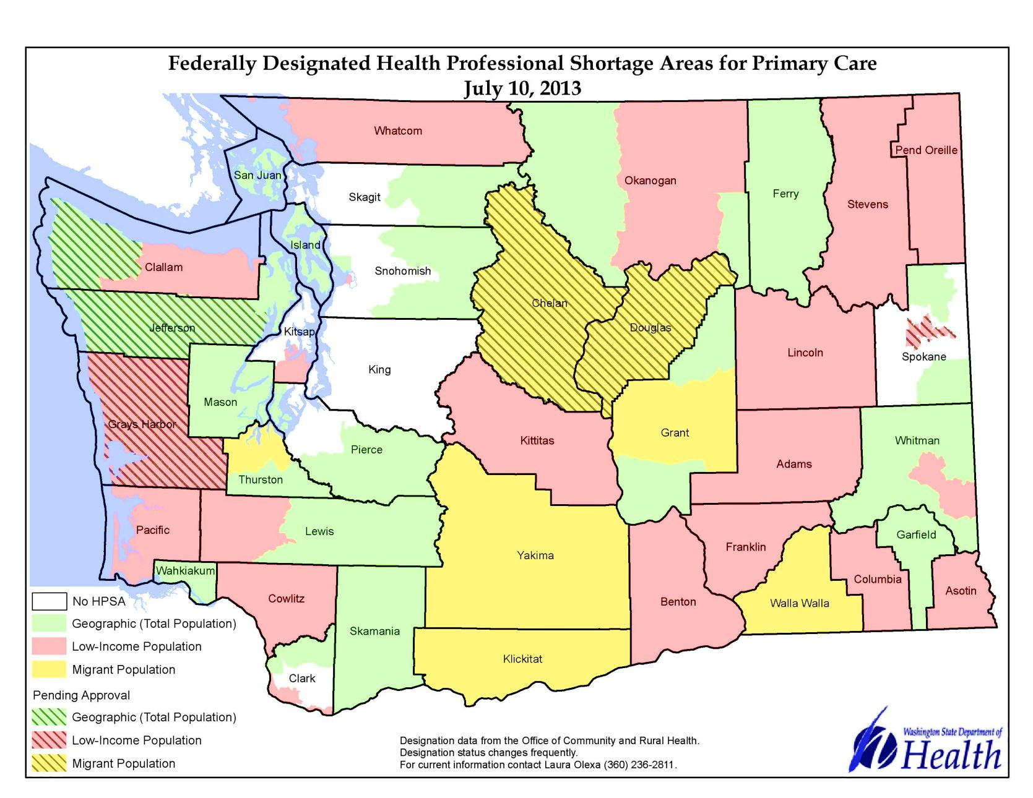
Rural Network in Eastern Washington

Slide 3
Members
Established in 2002 with HRSA Network Development Grant Program
7 Public Hospital Districts
7 Rural Hospitals, of which 6 are Critical Access Hospitals
12 Rural Health Clinics
Mission - To improve the health of our communities by creating an infrastructure designed to stabilize and strengthen the local rural health system.

Slide 4
Rural Health Disparities
Health Disparities in Rural Network Counties compared to Urban/State (2012)
In percent | WA | Lincoln | Pend Oreille | Grant | Garfield | Columbia | Spokane (urban)
Percent 65 or older | 13 | 22 | 21 | 12.1 | 23 | 24.8 | 13
Median Age | 37 | 47 | 47 | 31.6 | 49 | 48 | 36
Have Bachelor degree | 31 | 19 | 17 | 14.6 | 24.6 | 18.7 | 29
Unemployment | 6.6 | 7.6 | 10.9 | 9.6 | 7.8 | 10.2 | 7.3
Diabetes | 8 | 12 | 9 | 8 | 17 | 16 | 9
Heart disease | 5 | 9 | 8 | 7 | 10 | 9 | 6
Obesity (BMI= >30) | 27 | 32 | 31 | 38 | 31 | 38 | 28
High cholesterol | 40 | 47 | 45 | 43 | 50 | 48 | 39
 | WA | Lincoln | Pend Oreille | Grant | Garfield | Columbia | Spokane (urban)

Slide 5
Our Initiatives
Care Coordination and Care Transitions
Patient Centered Medical Home
Tele Health Services
Primary Care and Behavioral Health Integration
County Coalitions and Regional Collaborations
Chronic Disease Management and Measurement
Performance Reporting

Slide 6
Disparate Health Information Systems
 | Pend Oreille | Lincoln | Garfield | Grant
Hospital IS system | Meditech | Meditech | Dairyland | Meditech
EMR Vendor | GE Centricity | Allscripts | Soapware | GE Centricity
# Rural Health Clinics | 2 | 3 | 1 | 2
No central data repository to aggregate data
No tool to measure population base health data
Write a Grant…..

Slide 7
Rural Health Information Technology Network Development Grant Program
Awarded grant - 2011-2014
Implement a common disease registry
Chronic disease management of the patient
Local registry for management of a population
Aggregate our data across sites
Secure health information exchange
Track outcomes over time
Supports Patient Centered Medical Home NCQA recognition

Slide 8
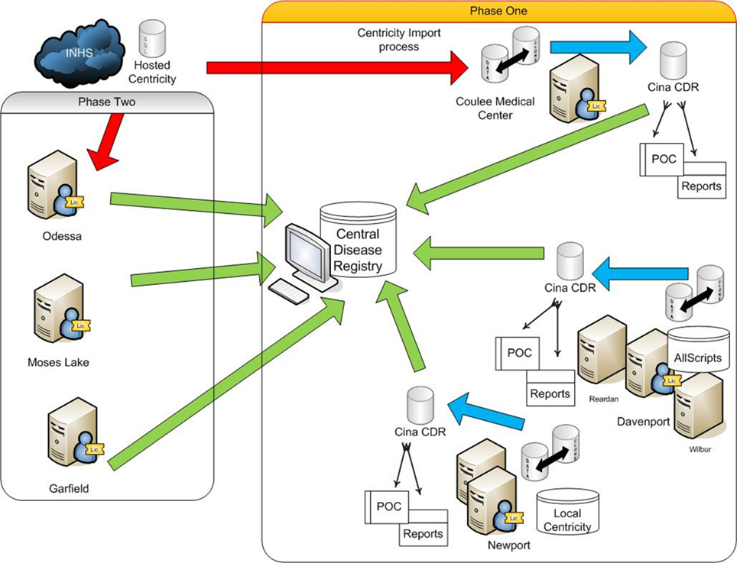
Architecture – Local Central Data Repository and De-Identified Aggregated

Slide 9
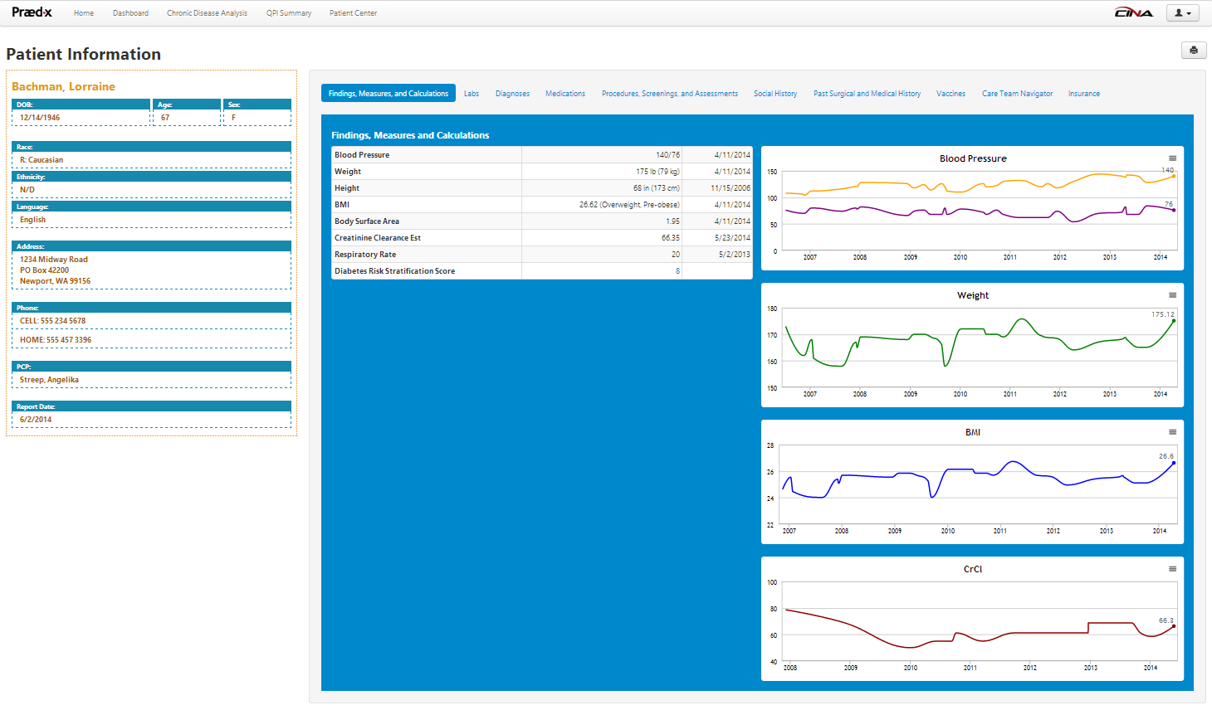
CINA

Slide 10
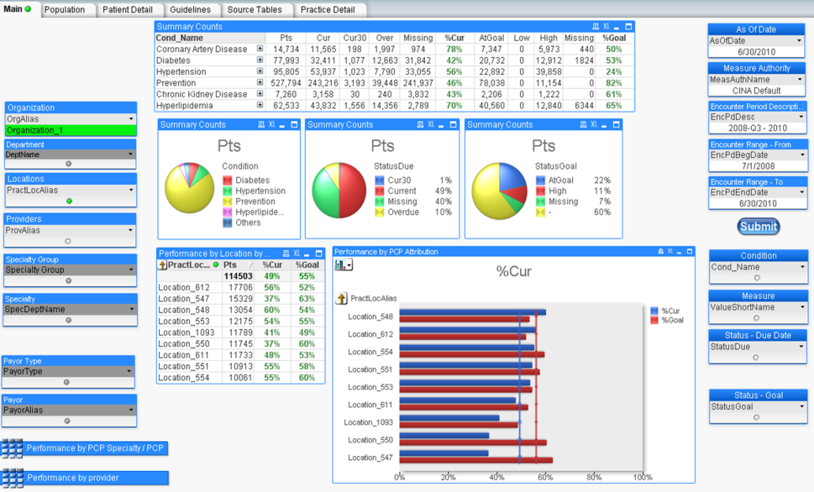
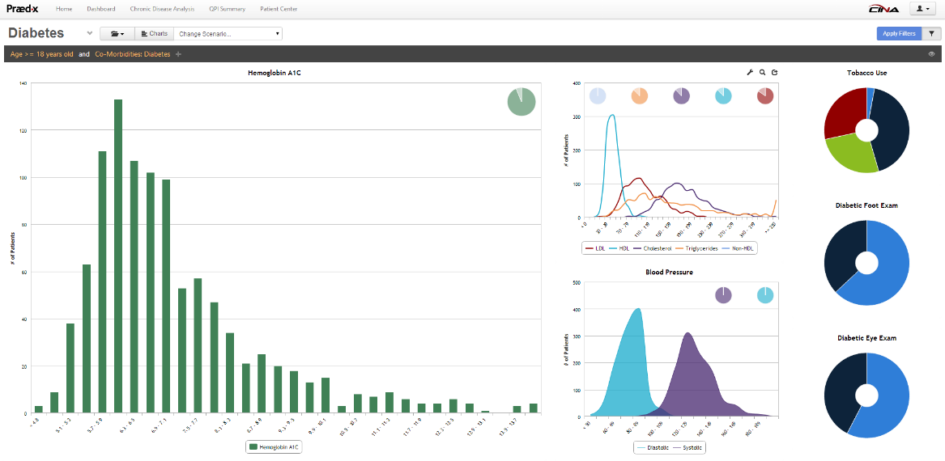
Developed a Population Health Tool
CINA Registry Tool

Slide 11
It’s Alive !!!
https://praedxlogin.com/Account/Login

Slide 12
Impact / ROI Population Health Data
Population based benchmark/goals chronic disease management (e.g. LDL, BP, A1c)
Inpatient admission rates/ED visits for populations with chronic diseases
Readmission rates after 30 days discharge
Provider satisfaction towards project interventions
Per visit revenue from increase in preventive procedures, labs and screenings triggered by CINA

Slide 13
Thank you
Sue Deitz, MPH
Director, Critical Access Hospital Network
suefox@sandpoint.net
(208)610-0937

