Slide 1
Strategic Business Planning: Building More Centralized Services
Tim Cox
June 2014
Notes:
This template can be used as a starter file to give updates for project milestones.
Sections
Right-click on a slide to add sections. Sections can help to organize your slides or facilitate collaboration between multiple authors.
Notes
Use the Notes section for delivery notes or to provide additional details for the audience. View these notes in Presentation View during your presentation.
Keep in mind the font size (important for accessibility, visibility, videotaping, and online production)
Coordinated colors
Pay particular attention to the graphs, charts, and text boxes.
Consider that attendees will print in black and white or grayscale. Run a test print to make sure your colors work when printed in pure black and white and grayscale.
Graphics, tables, and graphs
Keep it simple: If possible, use consistent, non-distracting styles and colors.
Label all graphs and tables.

Slide 2

Session Overview
What is the session about?
Why is this good for networks?
Describe potential services that fit this model
Describe the process
Focus on one specific service line
Notes:
What is the project about?
Define the goal of this project
Is it similar to projects in the past or is it a new effort?
Define the scope of this project
Is it an independent project or is it related to other projects?
* Note that this slide is not necessary for weekly status meetings

Slide 3

Session Content
What is Centralized Services?
What are the Benefits?
  Reduced Costs
  Increased Efficiencies
  Other Source of Revenues
  Improved Services
Is it Good for Networks?
Yes, It provides value that cannot be provided as a single entity

Slide 4

Current Status
What did we do and where are we right now in regards to the Strategic Business Plan?
Notes:
* If any of these issues caused a schedule delay or need to be discussed further, include details in next slide.

Slide 5
Northland Centralized Programs
BioMedical Engineering
Natural Gas Purchasing
Group Contracting
Mobile MRI
Account Collection
HIT Technical Assistance
PACE
Care Coordination
Group Purchasing
Grants Writing and Management
Health Connect
Notes:
Duplicate this slide as necessary if there is more than one issue.
This and related slides can be moved to the appendix or hidden if necessary.

Slide 6
Timeline
Milestone 1
Milestone 2
Milestone 3
Initial Board discussion Sept 2012
Milestone 4
Prepare drafts for Board review and approvals Oct 2013
Hire a consultant to facilitate planning and guide committee on planning Apr-Jul 2013
Established a structure taskforce and determine work outline Feb 2013
Notes:
The following slides show several examples of timelines using SmartArt graphics.
Include a timeline for the project, clearly marking milestones, important dates, and highlight where the project is now.

Slide 10
HIT Template
Notes:
Prepare slides for the appendix in the event that more details or supplemental slides are needed. The appendix is also useful if the presentation is distributed later.

Slide 11

Project Overview Outline
Purpose, Mission & Description
Value Proposition
Key Activities
Key Resources
Key Partnerships
Cost Structure
Revenue Streams
Notes:
What is the project about?
Define the goal of this project
Is it similar to projects in the past or is it a new effort?
Define the scope of this project
Is it an independent project or is it related to other projects?
* Note that this slide is not necessary for weekly status meetings

Slide 12
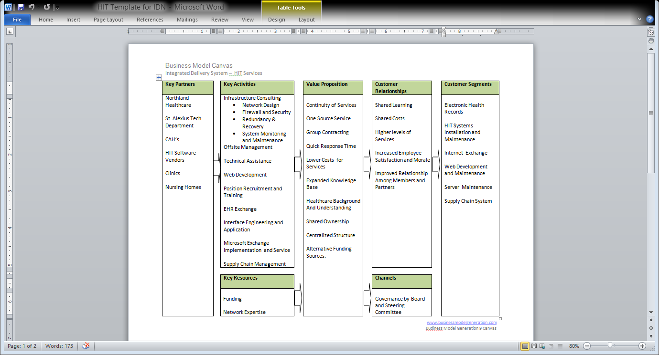

Slide 13
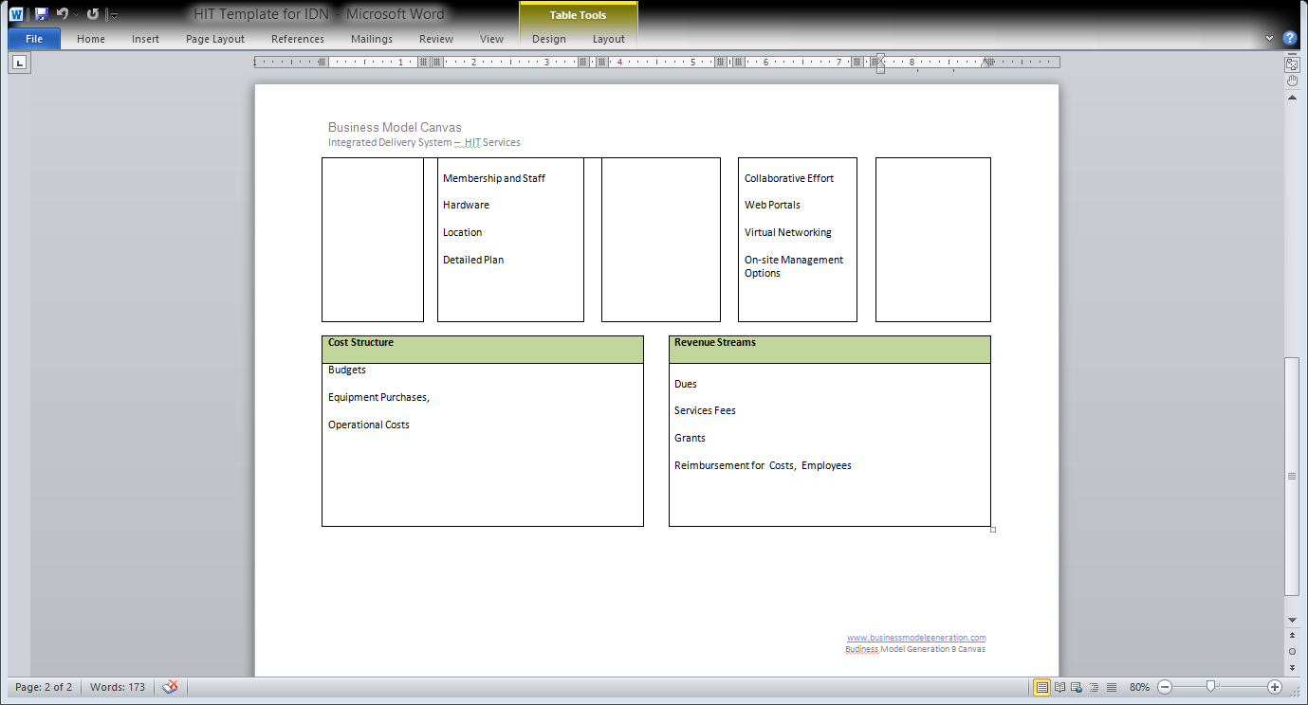

Slide 14
Dependencies and Resources
Project
Trained Staff
Member Commitment
Funding Plan
Communication
Effective Implementation
Notes:
What are the dependencies that affect the timeline, cost, and output of this project?

Slide 15
Additional Processes
Budget
Design documents
Marketing plan
Supplemental documents

Slide 16
White Paper Detail

