Slide 1
Network Presentation
”Making Data Meaningful for Improvement and Sustainability"

Slide 2
Presentation Topics and Goals
KRHIT Network – Who we are and what we do
HIT Activities – How members needs were met
Data Query Tool – Understanding the demand for data and implications for quality of care and service provision
Collaboration Process – Reframing data management, data analytics and data warehousing and lessons learned
Implications for the Future- Sharing ideas and resources

Slide 3
Kentucky Rural Health Information Technology Network
Members Include:
Private Practices
FQHCs
Critical Access & Rural Hospitals
RHCs
Services provided:
Assistance in EHR selection and implementation
Quality Reporting
Data Analysis
Business Valuation Information
HRSA Funded Organization with governing Board of Directors
Using Health Information Technology (HIT) to decrease health disparities and increase health outcomes

Slide 4

Vision
To provide the people of rural, southeastern Kentucky access to a full continuum of quality health services.

Slide 5

Mission
To facilitate and coordinate the development of an interconnected, secure data sharing network in support of quality rural health care for the medically underserved and to assist providers in the alignment of local efforts with emerging state and national guidelines.

Slide 6
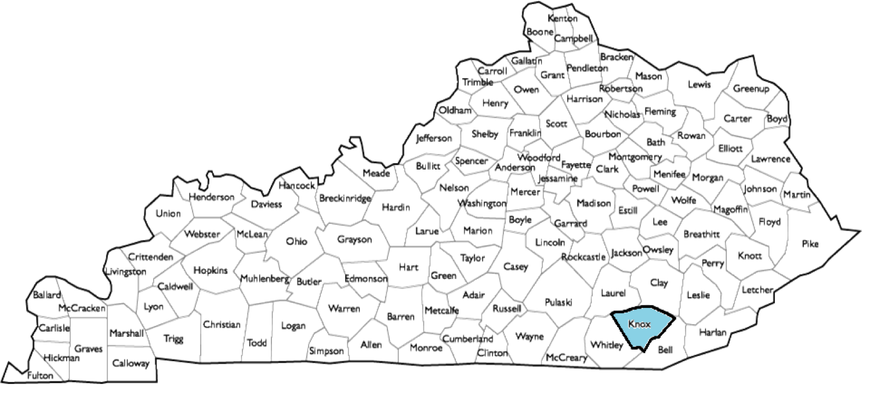
When Funded: 1 County

Slide 7
HIT Activities
Assist members in achieving meaningful use and receiving incentive payments (AIU)
Assisted in EHR implementation
Assisted in Purchase Practice Agreements
Develop IT Support Services to meet the needs of network members (expanding with NeKY RHIO)
Assisted members in reporting for quality improvement and meaningful use

Slide 8
HIT Activities
26 received incentive payments
26 providers attested to Stage 1 Meaningful Use
Provided HIPPA compliance
Introduced Online Backup solution at a reduced cost
Provided Technical Assistance
Supplied Technical Equipment
Meeting Members Needs
Notes:
Change the cost savings number

Slide 9
HIT Activities
FQHC Purchase of a Pediatric and a OB/GYN Practice
Provided RUV Calculations
Provided Billing Information
Helped In Business Valuation Process
Membership
Consolidation

Slide 10


HIT Activities
KRHIT and Northeast Kentucky RHIO to provide IT support services.
Helps recruit membership and build sustainability
The HCCN grant includes 22 FQHC’s in KY.
KRHIT will develop a database of clinical and financial measures.
KRHIT will provide CIO services to the HCCN for a fee.
KRHIT lead partner in a recently awarded Health Center Controlled Network Grant

Slide 11

Accomplishments
Significant expansion of KRHIT membership
Development of key partnerships
Provision of equipment and technical assistance to members
Shared Understanding of the Significance of Data
Notes:
Explain partnerships developed

Slide 12
Data In Healthcare
National Quality Strategy
Affordable Care Act Initiatives
PQRS
PCMH
ACO

Slide 13
Why Data is Important
Estimates of death from preventable medical errors range from 100,000 to 225,000 annually
This equates to 250-550 Boeing 747-300 airliner catastrophic accidents annually.
http://wcqi.asq.org

Slide 14
National Quality Strategy
Better Care
Affordable
Care
Healthy People & Communities
Health Information Technology
Data
Notes:
Data Drives this process

Slide 15
Affordable Care Act Initiatives
Transitions of
Care Initiatives
Meaningful
Use
State
Innovation
Models
PCMH
ACO’s
PQRS

Slide 16
PQRS
Physician Quality Reporting System
  Uses a combination of incentive payments and payment adjustments to promote reporting of quality measures by eligible professionals (EPs)
Sample Measures:
Measure Number | Measure Title | Reporting Options (Claims, Registry)
1 | Diabetes: Hemoglobin A1c Poor Control | C, R
51 | Chronic Obstructive Pulmonary Disease (COPD) : Spirometry Evaluation | C, R
53 | Asthma: Assessment of Asthma Control: Ambulatory Care Setting | R
www.cms.gov

Slide 17
PCMH
Patient Centered Medical Home
Organizing Primary Care that emphasizes care coordination and communication to transform it into “what patients want it to be”.
Do you and your staff foster a culture of improvement?
Incorporate quality improvement into daily work
Establish core performance measures
Collect and analyze data for better clinical management
Discuss best practices and ways to improve

Slide 18
ACO
Groups of doctors, hospitals, and other health care providers who come together voluntarily to give coordinated high quality care to Medicare patients, avoiding unnecessary duplication of services.
5 Domains Evaluation Quality of ACO Performance
1. Patient/Caregiver Experience
2. Care Coordination
3. Patient Safety
4. Preventative Health
5. At-risk Population/Frail Elderly Health

Slide 19
Barriers in Data Collection Experienced by KRHIT Member Organizations
Staff are still trying to learn how to operate their EMR.
Identify, understand, and implement clinical workflows
Struggle with understanding their EHR reporting systems/formats
Organizations don’t have IT staff to grasp databases
*
*
*
*

Slide 20
KRHIT Helped Members Collect Data
Clinical Quality Data
UDS
MU
340B
Operational Data
Encounter Rates
No Show Rates
Provider Production
Financial Data
Budget Information
Billing Information

Slide 21
Example of Clinical Quality
CLINICAL MEASURE | Goal | UDS 2012 | Qtr 1 | Qtr 2 | Qtr 3 | Qtr 4 | UDS 2013
Hypertension | 65% | 79% | 63% | 67% | 74% | 60.90% | 62.80%
The most current blood pressure below 140/90
Diabetes | 80% | 76% | 76% | 62.30% | 23.50% | 50% | 73.00%
Percent of patients with most recent HgbA1C<9
Pap Smear- Cervical Cancer Screening | 60% | 27% | 35% | 1.60% | 27% | 19.40% | 42.85%
Documented lab confirmation of pap smear in past 2 yrs

Slide 22
Example of Operational Data
 | Patient Encounters Summary (Medical)
 | Total Monthly Encounters | Monthly Budget | % of Budget | Total Encounters YTD | Total Encounters YTD Budget | % Budget YTD | % Medicaid YTD | % Medicaid Budget | % of Goal
County 1 | 1,055 | 1,120 | 94% | 2,600 | 3,183 | 82% | 35.80% | 28.00% | 128%
County 2 | 298 | 316 | 94% | 864 | 790 | 109% | 33.20% | 25.00% | 133%
County 3 | 428 | 432 | 99% | 1,098 | 1,009 | 109% | 41.90% | 28.00% | 150%
County 4 | 156 | 185 | 84% | 221 | 493 | 45% | 66.50% | 65.00% | 102%

Slide 23
Example of Financial Data
 | Financial Markers (Medical)
 | Net Patient Revenue Monthly | Monthly Budget | % of Budget | Net Patient Revenue YTD | Net Patient Revenue YTD Budget | % of Budget | Days in AR | Days in AR Goal
County 1 | 117,108 | 99,670 | 117% | 281,091 | 283,272 | 99% | 40.53 | <45
County 2 | 32,733 | 26,727 | 122% | 89,365 | 66,817 | 134% | 82.94 | <45
County 3 | 50,104 | 38,501 | 130% | 127,816 | 89,835 | 142% | 252.52 | <45

Slide 24
UDS (FQHCs)
Uniform Data System
Core set of information appropriate for reviewing the operation and performance of health centers.
What Data are Collected?
Patient demographics
Services provided
Staffing
Clinical indicators
Utilization rates
Costs
Revenues

Slide 25
KRHIT Data Idea
#1
Start reporting process (PQRS, MU)
#2
Identify opportunities for Data Sharing
#3
Workflow PCMH Alignment
#4
Capacity Building

Slide 26
Collaboration Process
Help Kentucky Create First Health Center Controlled Network
22 FQHC Organizations with over 500,000 Encounters and 10 Different EMR Programs
HCCN HIT Grant helps FQHCs Understand Importance of Data, Protocols, and Best Practices
KRHIT Introduces a Data Warehouse Proposal

Slide 27
What is the ultimate purpose of a database management system
Data
Information
Knowledge
Action
Notes:
Data- Raw Information, Info- AIC’s to Diabetic Patients (Correlation), Knowledge- Pass on info to clinical quality person

Slide 28




It Takes a Team
Nurse/MA
Doctor
IT Specialist

Slide 29
Health Needs:
Kentucky among poorest and least healthy states.
Participating health centers served 443,482 patients last year.
Majority of patients White (84%) and female (62%).
More than 82% of patients are at or below 200% of the federal poverty level.
According to 2011 UDS data, 37.9% of patients uninsured, 30.5% covered by Medicaid and CHIP, and 10.5% participate in Medicare program.
US Census Bureau, State and County Quick Facts
www.hrsa.gov

Slide 30
Data Warehouse and Benchmarking
Kentucky Rural Health IT to develop interfaces, build data warehouse, run analytics and provide benchmarking portal
Data ownership; your data always
Data use: opt in/opt out
Data safety: read only
Create process to select measures beyond UDS, MU and PCMH

Slide 31
Data Management, Analytics, and Benchmarking
KRHIT Network will:
Build vendor neutral warehouse
Interface with EMR’s from participating Health Centers
Normalize Data
Provide analytics
Display comparative data for benchmarking purposes

Slide 32
Where your data sits
Database (FQHC)
Table (Lab Values)
A1C= 9.0 CBC= 150,000
Level I
Read Only !!
Level II
Level III

Slide 33
How we move your data
Authorized HCCN Members
Clinical EMR Community Health Center
Report Server (if applicable)
HCCN Data Warehouse
Secure Portal
Read Only !!
Secure Copy
Normalized

Slide 34

Hurdles along the way…
Trust
Advocate at Executive Level
Perception of Complexity
No Real Financial Value

Slide 35
Reframing Data Management

Slide 36


Final Objective
Data Center Model
Best Practice Evaluation

Slide 37



Inside Out Approach
Management/Quality/Auditing
EMR
Reporting
Provider
Clinical Workflow

Slide 38
Inside Out Approach
Incorrect
Reporting
Incorrect Workflow
Management/Quality/Auditing
EMR
Reporting
Provider
Clinical Workflow

Slide 39

Inside Out Approach
Management/Quality/Auditing
Incorrect
Reporting
Reporting
Select Evaluation Measures
Data Query Tool Pulls Information From EMR
Work With Organizations like REC to Correct Issues
EMR
Provider
Incorrect Workflow
Data Query Tool
Clinical Workflow

Slide 40
Final Outcome
PCMH
Other revenue generating opportunities
UDS
KHCN Best Practice
Data Center
ACO

Slide 41
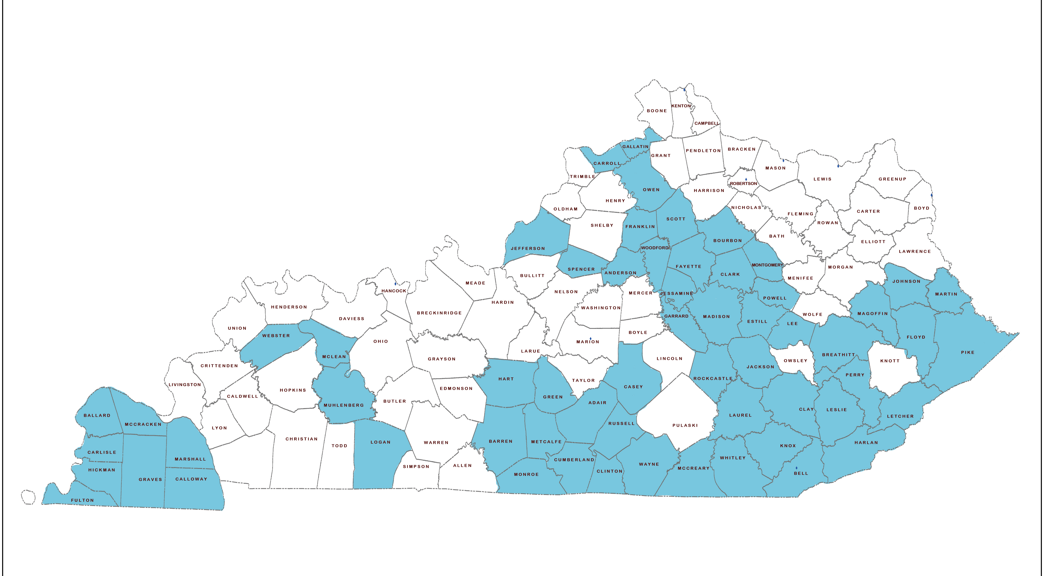
Covering 60 Counties

Slide 42
Hurdles with final proposal…
Legal
Advocate at Executive Level
10 EHRs
General Fears

Slide 43
Screen Shots of Software
Sample Software

Slide 44
Questions

