Slide 1
Feasibility of Multi-Stakeholder Cooperative in Delivering Rural Home Care
2014 NCHN Annual Educational Conference
Presentation by
Susan Noble, Executive Director
Vernon Economic Development Association
Thursday, June 19, 2014

Slide 2
Multi-Stakeholder Approach to Rural Home Care
CDF USDA RCDG grant
Vernon County Discovery Process
Purpose: Feasibility of a multi-stakeholder cooperative to meet the needs of seniors & special needs population groups in providing home care

Slide 3
Multi-Stakeholder Approach to Rural Home Care
Organizations:
Vernon Economic Development Association
Vernon County Unit on Aging
Vernon Memorial Healthcare
Bethal Home & Services
Vernon County Aging & Disability Resource Center
USDA Cooperative Development Specialist
Vernon County Veterans Service
Western Technical Collage
Gundersen Health System
Center Point Counseling Services Co-op
Department of Vocational Rehabilitation
UW-Extension
Wisconsin Farmers Union
Private home care providers

Slide 4
Multi-Stakeholder Approach to Rural Home Care
Discovery Process:
Nine monthly meetings
to explore….
Purpose of Discovery Process; presentation from Cooperative Care
Data on supply & demand for home care in the County
Review of Affordable Care Act & implications
Review of cooperatives & structure
Purposes & benefits of multi-stakeholder co-op

Slide 5
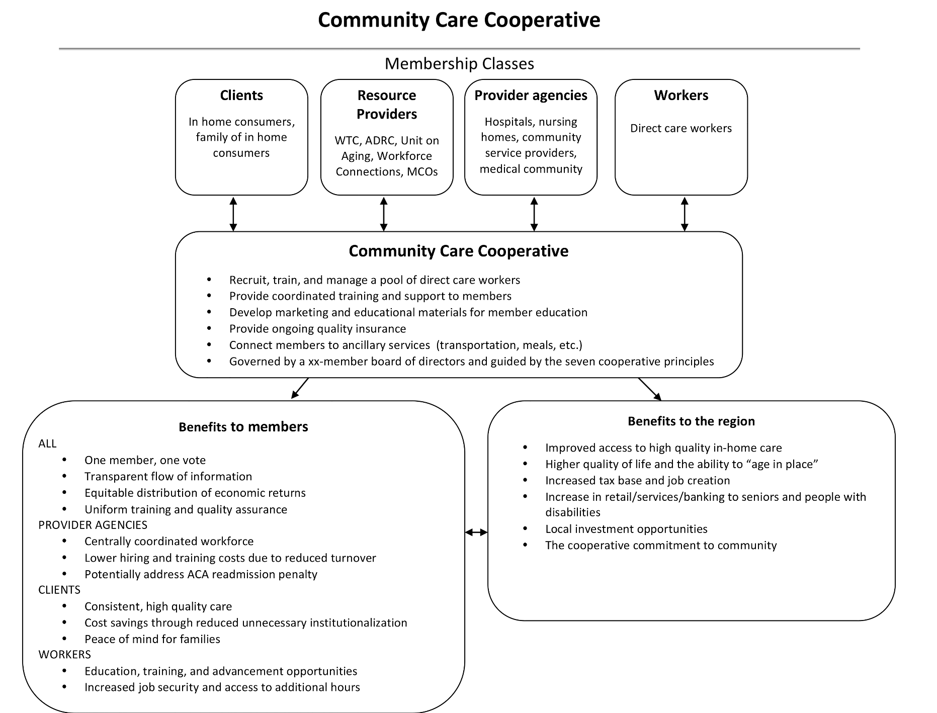

Slide 6
Multi-Stakeholder Approach to Rural Home Care
The group engaged a consultant who provided the following selected Feasibility Study observations:
More involvement and understanding of the current and potential clients is needed
Staffing and wage issues, could be among the most challenging
Developing a career path for home care workers would attract a younger labor force
All stakeholders, and especially cooperative members, need to see both immediate and long-term benefits for the individual companies
The reality of all new businesses and organizations is that funding at all levels will be problematic
New ideas are often successful when marshaled by a “political champion”
Business viability is difficult to determine when the policy environment is fluid

Slide 7
Multi-Stakeholder Approach to Rural Home Care
What we accomplished through the series of meetings: 1) Gained communication among caring professionals about the needs, community resources and overall goals to have needed long term care services in Vernon Co and quality staff to provide them 2) Identified a variety of needs & ways to provide services 3) Identified barriers to implementation including funding and resistance to competition 4) Struggled with the next steps due to not identifying a “champion” to lead the effort. It was valuable for all.
Why am I still involved? It is still a work in progress and I believe the need is critical to find a solution to have home based health care & assistance. It will be great to be proactive and prepared for the growing need, rather than reactive and unable to help those with needs should services not be ramped up in time for the growing numbers of residents over age 65.
-- Pat Peterson, Director, Vernon County Unit on Aging

Slide 8
Multi-Stakeholder Approach to Rural Home Care
This group aimed at tackling some important issues faced by job applicants in this field.
I hope we will accomplish a development model that supports these types of positions (career ladder, benefits, living wage, employer access, training, standardization, etc.) -- Anthony Shay, M.A., L.P.C., C.R.C., Vocational Rehabilitation Counselor

Slide 9
Multi-Stakeholder Approach to Rural Home Care
My reason for being involved was twofold; first, as a provider of home care I was curious about the genesis of the study and how it may impact our organization. Second, our mission asks us to seek out ways to provide quality care to the aging in our communities while our corporate philosophy and values ask us to explore partnerships that we feel will better help us to provide quality care.
My hope is that we will accomplish both the development of a network of care agencies available to clients in need of service, and the incubator for new services that we identify without duplicating services already in place. -- Clark D. Nordberg, Chief Executive Officer, Bethel Home and Services Inc.

Slide 10
Multi-Stakeholder Approach to Rural Home Care
I stayed involved with the group because there is a need for mental health services for clients and caregivers. After learning more, a collaboration of providers makes sense. We want to provide whatever support we can.
I hope the group is able to determine the feasibility of creating a cooperative (or similar collaboration) and/or commitment to move this forward. -- Sheri Hammond, General Manager, Center Point Counseling Services Cooperative

Slide 11
Multi-Stakeholder Approach to Rural Home Care
Areas for collaboration:
Pool demand for hours – (help direct care workers get 35-40 hours per week) to stabilize the workforce
Shared Training
Increased education and marketing among agencies and within the community

Slide 12
Multi-Stakeholder Approach to Rural Home Care
Key Lessons:
People kept coming to the meetings – obviously see a need
Difficult to think out of the Medicare/Medicaid reimbursement box
Need support of the institutions but their missions create barriers for collaboration
Project will not move forward without a Champion

Slide 13
Multi-Stakeholder Approach to Rural Home Care
Next Steps:
Bring group back together
Review final feasibility report
Explore Village to Village as go-forward strategy
Commitment to helping elders and special needs population groups to stay home with quality assistance

Slide 14
Multi-Stakeholder Approach to Rural Home Care
Thank you!
Questions?
Discussion

