Slide 1
Creating a Regional Collaborative
Steps and Tools to Prepare a Rural Community for Healthcare Transformation

Slide 2
Topics
Intro to FDRHPO
Strategies
Tools
Bringing it all together

Slide 3
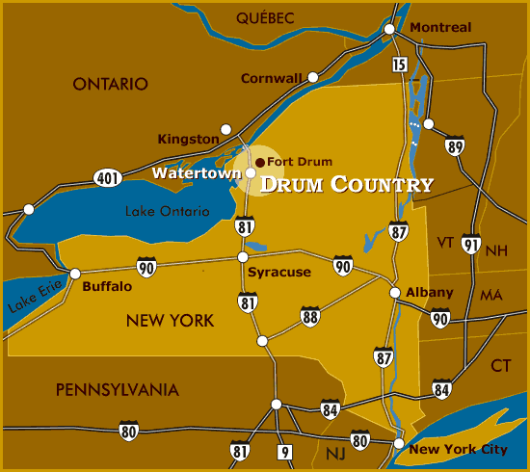
Intro to FDRHPO

Slide 4
Intro to FDRHPO
About us or WIIFM
Rural community (Tri-County)
Total population (2012 estimate) = 259,718
From 42 to 92 persons per square mile compared to the NYS average of 411.
Health Provider Shortage Area (HPSA)
Average of 50% less then the NYS Average
Economy dependent on Fort Drum
Fort Drum Contributed $1.4B to the region in 2013

Slide 5
Strategies
Governance
Board
Provider Executive Committee
Committees & Workgroups
Advocacy
Healthcare transformation primer

Slide 6
Strategies
Board
Clinically Integrated Network (CIN)
Workforce Development
EMS
Provider Executive Committee
Executive Steering Committee
Managed Services Organization
Revenue Cycle WG
Shared Lab WG
Group Purchasing WG
Quality Metrics WG
Care Transitions WG
Telemedicine WG
HIT WG
Behavioral Health WG
Jefferson County EMS Cooperative (JEMSCO)
Technology
North Country Health Information Partnership
External Partners
North Country Healthcare Providers
Adirondack Champlain Telemedicine Information Network
North Country Health Compass

Slide 7
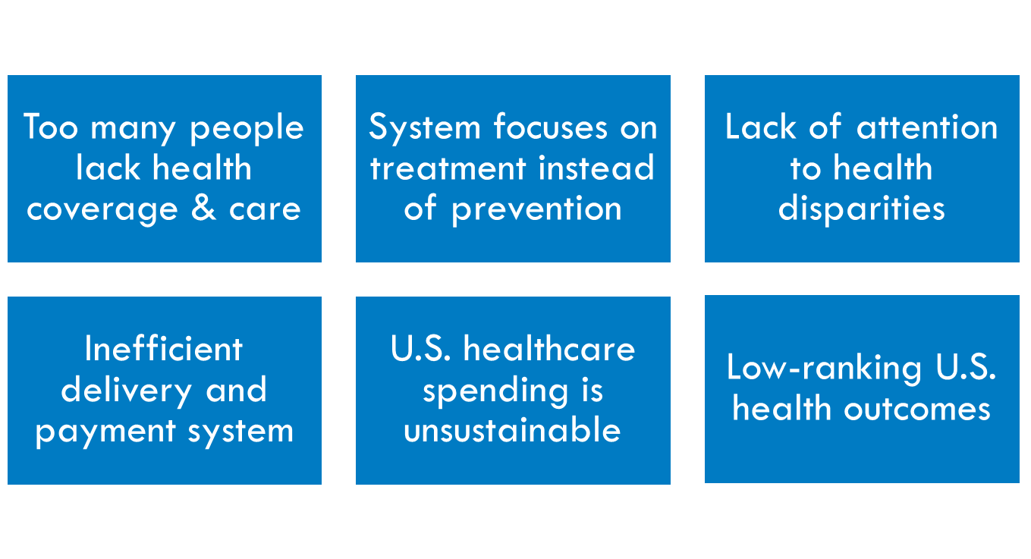
Healthcare Transformation Primer – The Need for Health Reform
Strategies
Why do we need the Affordable Care Act: http://www.apha.org/advocacy/Health+Reform/ACAbasics

Slide 8
Strategies
Healthcare Transformation Primer – The Death Spiral
Consumer can't afford doctor
Consumer delays care, goes to ER
Consumer can't pay
Providers shift cost to insurers
Insurers shift cost to consumer
Consumer drops policy due to high price and is now uninsured

Slide 9
Strategies
Healthcare Transformation Primer – Achieving the Triple Aim
Institute for Healthcare Improvement: www.ihi.org
Notes:
Overview of ACA- how it is impacting healthcare through the lens of the Triple Aim
Ian to talk about population health, you to discuss cost and experience of care

Slide 10
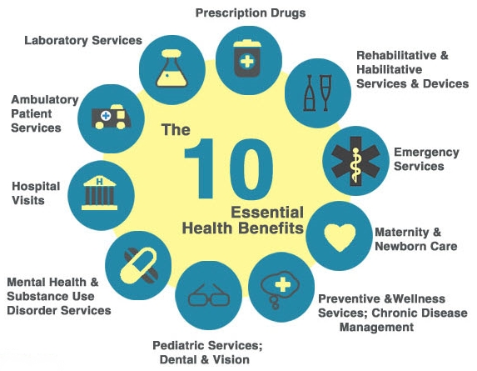
Strategies
Healthcare Transformation Primer – Ten Essential Health Benefits
Essential Health Benefits: www.healthcare.gov/news/factsheets/2011/12/essential-health-benefits12162011a.html

Slide 11
Strategies
Healthcare Transformation Primer – Integrating Behavioral Health
GA-U: General Assistance Unemployable
AOD: Alcohol and Other Drugs
MI: Mental Illness
National Council for Community Behavioral Health: www.TheNationalCouncil.org

Slide 12
Strategies
Healthcare Transformation Primer – Flipping the System
Acute Care
Specialty Care
Prevention
&
Primary
Care
Acute Care
Specialty Care
Prevention & Primary Care
Current State
Future State

Slide 13
Tools
EHR, HIE & Registries (Lions, Tigers & Bears, Oh My)
Telemedicine and Telehealth
Patient-Centered Medical Home (PCMH)
Clinical Integration
Care Managers

Slide 14
Service Intensity
Tell
Help
Do
Other
Speed
Impact on Internal Practice Resources
Cost*
*Cost is mitigated and often much lower due to resources being local

Slide 15
EHR
HIE
Disease Registry
Strengths
Excellent at individual point of care
Excellent workflow and patient-centric care
Can do some population disease management through manual reporting
Strengths
Excellent at care coordination across the community
Excellent at consolidating regional care documentation into a single summary
Strengths
Excellent reporting tools
Comprehensive dataset (can pull almost anything from EHRs & HIS)
Can report directly to PQRS and other quality incentive programs
Preconfigured metrics based on standards (i.e. HEDIS)
Weaknesses
Limited care coordination outside of practice without the Health Information Exchange (HIE)
Cannot compare clinical quality with regional metrics
Some quality incentive programs will not accept direct reporting
Weaknesses
No support for individual workflow inside a practice (view only without an EHR)
Limited in collecting quality metrics by the data available from the EHR interfaces, leading to an incomplete dataset
Weaknesses
No care coordination or workflow
Population centric, may need EHR and or HIE to drill down to patient level

Slide 16
Tools
Regional Health Information Technology Toolsets
.
Disease Registry
HIE
EHR
Inputs – Public payer claims and census data, population surveys
Outputs – Mortality rates, socioeconomic factors and community-based disparities by county, by hospital, by service line
Who would use – Public Health, Community-Based Organizations, Health Planners, and Hospital strategic and marketing planners.
Who would use – Public Health, primary care practices/clinics and Hospital quality and readmissions teams. Clinically Integrated Network Physician Leadership. Clinical Analytics
Outputs – Clinical quality and population health measures and actionable patient lists for follow-up
From clinics/practices – Prob lists, demo data, dx and treatment
From Hospitals – Lab and demo data, dx and treatment
Inputs
Outputs – Legal patient record, clinical decision support and billing
Inputs
Pharmacy Data
From Hospitals – Lab and demographics data, radiology imaging, reports and other transcribed reports
From clinics/practices (future planned development) – Problem lists, demographics, diagnosis and treatment
Outputs – Real-time results delivery to providers and patient summaries from all sources
Who would use – Primary, Specialty, Emergency and Hospital Providers at the point of care – Secondary source
Who would use – Primary, Specialty, Emergency and Hospital Providers at the point of care - Primary source
Inputs – Clinical and demographical data entered either directly by providers and other clinical and administrative staff or data from the HIE
Aggregation Level
Patient Specific Information
3 – 5 yr View
1 - 2 yr View
Secondary Now view
Now
View

Slide 17
Telemedicine Access Decision Tree
Payer
Medicare
Medicaid
Tricare, Martin’s Point, Excellus or Pomco
Lewis County Clinic/LTC
Lewis County Private Practice
St. Lawrence County Private Practice
St. Lawrence County Clinic/LTC
Lewis County Clinic/LTC
St. Lawrence County Clinic/LTC
Lewis County Clinic/LTC
Lewis County Private Practice
St. Lawrence County Private Practice
St. Lawrence County Clinic/LTC
Jefferson County Clinic/LTC
Jefferson County Private Practice
North Country Family Health Center
Jefferson County Clinic/LTC
Tools
Notes:
Medicaid Pays only for sessions (both hub and spoke) conducted at an (hospital owned) Article 28 clinic.
Will pay for the spoke site being an FQHC only if they have opted for the APG payment model (bundling).
Currently, the North Country Family Health Center has not elected this model and is, therefore, ineligible for Medicaid.
Medicare
Pays only for clinical setting (practice, clinic or hospital), not home-based at either the hub or spoke end.
Spoke end must be in an area designated as Rural.
Currently the Fort Drum-Watertown-Adams tract has been designated a Metropolitan Statistical Area (MSA) and if a county has one of these in it, the entire county cannot be designated rural.
Therefore, all of Jefferson County is ineligible for Medicare reimbursement as a spoke site, but is eligible to provide services as a hub site to other spoke sites that have the rural designation, i.e. Lewis and St. Lawrence Counties
Tricare, Martin’s Point, Excellus Blue Cross/Blue Shield
Pays only for clinical setting (practice, clinic or hospital), not home-based at either the hub or spoke end.
Pomco
Pays only for clinical setting (practice, clinic or hospital), not home-based at either the hub or spoke end.
Has been added to the list of authorized services, but is still up to the employers to select a plan (group) that offers this service.
Others
Need to initiate conversations with other payers, prioritized by volume.

Slide 18
Tools
Why the Medical Home Works: A Framework
Feature
Definition
Sample Strategies
Potential Impacts
Patient-Centered
Supports patients and families to manage & organize their care and participate as fully informed partners in health system transformation at the practice, community, & policy levels
Dedicated staff help patients navigate system and create care plans
Focus on strong, trusting relationships with physicians & care team, open communication about decisions and health status, compassionate/culturally sensitive care
Patients are more likely to seek the right care, in the right place, and at the right time
Comprehensive
A team of care providers is wholly accountable for patient’s physical and mental health care needs – includes prevention and wellness, acute care, chronic care
Care team focuses on ‘whole person’ and population health
Primary care could co-locate with behavioral, oral, vision, OB/GYN, pharmacy, etc
Special attention paid to chronic disease and complex patients
Patients are less likely to seek care from the emergency room or hospital, and delay or leave conditions untreated
Coordinated
Ensures care is organized across all elements of broader health care system, including specialty care, hospitals, home health care, community services & supports, & public health
Care is documented and communicated effectively across providers and institutions, including patients, primary care, specialists, hospitals, home health, etc.
Communication and connectedness is enhanced by health information technology
Providers are less likely to order duplicate tests, labs, or procedures
Better management of chronic diseases and other illness improves health outcomes
Accessible
Delivers consumer-friendly services with shorter wait-times, extended hours, 24/7 electronic or telephone access, and strong communication through health IT innovations
Implement efficient appointment systems to offer same-day or 24/7 access to care team
Use of e-communications and telemedicine to provide alternatives for face-to-face visits and allow for after hours care
Focus on wellness and prevention reduces incidence / severity of chronic disease and illness
Committed to quality and safety
Demonstrates commitment to quality improvement through use of health IT and other tools to ensure patients and families make informed decisions
EHRs, clinical decision support, medication management to improve treatment & diagnosis.
Establish quality improvement goals; use data to monitor & report about patient populations and outcomes
Lower use of ER & avoidable hospital, tests procedures & appropriate use of medicine = cost savings

Slide 19
Tools
Clinical Integration
Governance
Incentive Program Design
Care Managers
Good Clinical, Operational, Financial Information (DRIP)

Slide 20
Bringing It All Together
Why now?
Cost, Quality and the Patient
Governance
Provider leadership
Allied provider involvement
Data governance
Input
Normalization
Output
Assembling the right tools
EHR/PHR
HIE
Registry
Community data

Slide 21
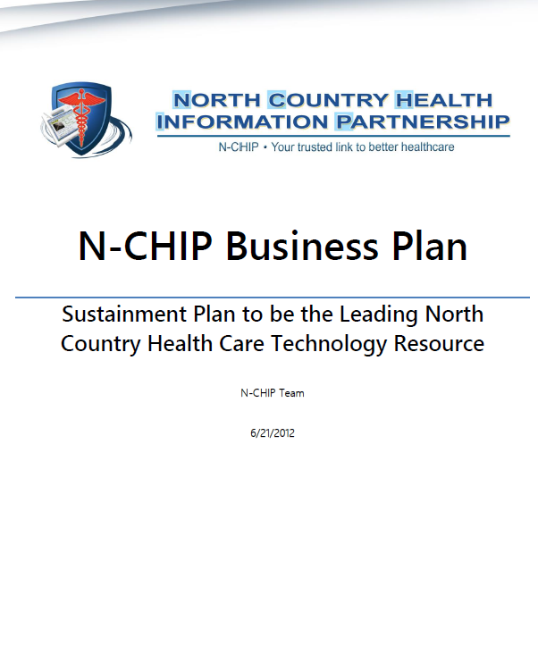
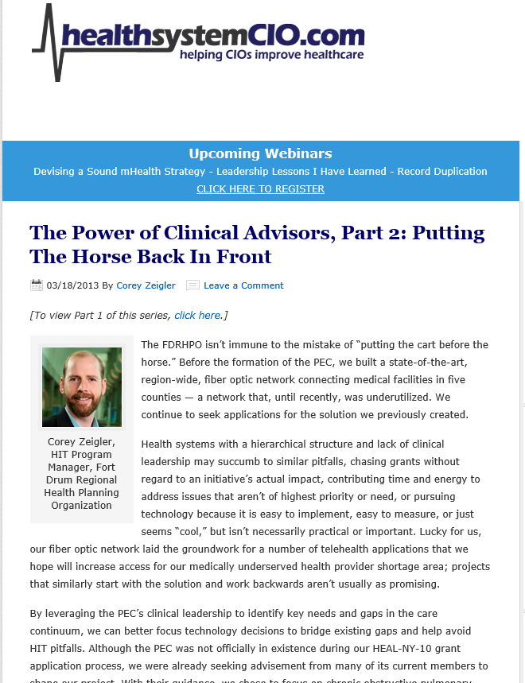
Resources
Building a Community-Based Chronic Disease Interventions – A Handbook
Article in Health System CIO RE: Clinical Governance
Article in Health System CIO RE: Clinical Governance (Part 2)
NCHIP Business Plan for Sustainment
https://sharepoint.fdrhpo.org/public/nchipPublic

Slide 22
Questions & Discussion
Fort Drum Regional Health Planning Organization
120 Washington Street, Suite 230
Watertown, NY 13601
(315) 755-2020
www.fdrhpo.org
czeigler@fdrhpo.org

