Slide 1
Care Coordination Opportunities for Networks: The Community Care Organization
National Cooperatives of Health Networks St. Louis, Missouri
Patricia Schou
President
Illinois Critical Access Hospital Network (ICAHN)
Carolyn Bruce
CEO
Western Healthcare Alliance
California Critical Access Hospital Network
June 18, 2014

Slide 2
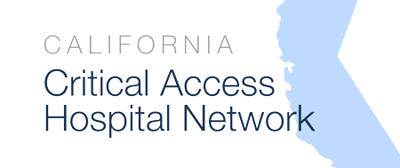
Today’s presentation & discussion
01
5 Stages of Grief
Network member’s loss of current reimbursement models. Your members?
04
Developing Models
Evolving to 2nd curve reimbursement
Member’s core values, R&D process
02
Population Health
What is it and why rural hasn’t been able to participate
05
Collaboration
Producing benefits across multiple networks
03
Season of the Network
New role for rural health networks
Why members are engaged
06
Moving Forward
Collaborating in rural healthcare delivery
Notes:
TABLE OF CONTENTS WILL CORRESPOND WITH THE “WHERE AM I” indicating bars on the bottom IN SUBSEQUENT SLIDES.
Gayle—please make sure colors all match up

Slide 3
Denial, 2011
Notes:
“Health care reform reimbursement changes aren’t gonna happen here.”
On March 23, 2010, President Obama signed comprehensive health reform, the Patient Protection and Affordable Care Act, into law.
2010-2011… Denial – the first of five Stages of Grief over the loss of the current reimbursement models, the loss of revenue
Implementation timeline from the Kaiser Family Foundation: http://kff.org/interactive/implementation-timeline/
In rural Illinois, Colorado and California a combined total of 110 rural healthcare providers didn’t even want to talk about it
discussed the ACA
Discussed how they WERE’NT going to discuss the ACA
Declared that the legislation wouldn’t last, wouldn’t happen in their market, wouldn’t need to be addressed by the network
They were in good company… During the health care debate, the Mayo Clinic, the Cleveland Clinic, Geisinger Health System and Intermountain Healthcare declined to apply for the “Pioneer ACO” program tailor-made by the Obama administration to reward such organizations.

Slide 4
Anger, 2012
Notes:
2011-2012 “We have too many fires to put out to deal with the ACA!”
Will Reform “Stick”??
Supreme Court; ObamaCare has been taken to the Supreme Court once already for repeal. Been attempted to be repealed by the house and senate over 30 times.. The Supreme Court ObamaCare ruling was a 5-4 ruling to uphold the Affordable Care Act. The final Ruling on ObamaCare had a few implications ranging from ObamaCare being defined as a tax and not a mandate and a choice for States to Opt-Out of Medicaid Expansion
June 28, 2012. Supreme Court ObamaCare Ruling
The final ruling on ObamaCare was a made by Supreme Court Judge Vinson. The basic idea of the ruling was that ObamaCare was declared a tax and not a mandate and was therefore declared constitutional.
Networks begin to discuss a way to survive 1st Curve Reimbursement to 2nd Curve Reimbursement and Population Health care delivery.
The ruling also let State's opt-out of expanding Medicaid, almost half of U.S. States opted out of expanding Medicaid in 2014 as of October 2013 leading to millions of our nations poorest going without coverage.

Slide 5
Bargaining, 2013
Notes:
Members begin to proactively address their future:
2012 – 2013 “Death by 1,000 Cuts continue to decrease reimbursement
Value-based purchasing program
Readmission penalties
Hospital acquired condition penalties
RBRVS adjustments
SGR cuts
Annual update & geographic adjustment reductions
DSH payment reductions
IPAB actions to reduce covered services
RAC audits
Bundled payment initiative
Sequester reimbursement cuts
Sequester EHR Incentive Program cuts
Combined Part A & B deductible?
DRG reform?
Premium support?
President’s new budget with more cuts on the table
OIG & congressional scrutiny of CAH cost reimbursement
Supreme Court; ObamaCare has been taken to the Supreme Court once already for repeal. Been attempted to be repealed by the house and senate over 30 times.. The Supreme Court ObamaCare ruling was a 5-4 ruling to uphold the Affordable Care Act. The final Ruling on ObamaCare had a few implications ranging from ObamaCare being defined as a tax and not a mandate and a choice for States to Opt-Out of Medicaid Expansion
June 28, 2012. Supreme Court ObamaCare Ruling
The final ruling on ObamaCare was a made by Supreme Court Judge Vinson. The basic idea of the ruling was that ObamaCare was declared a tax and not a mandate and was therefore declared constitutional.
Networks begin to discuss a way to survive 1st Curve Reimbursement to 2nd Curve Reimbursement and Population Health care delivery.
The ruling also let State's opt-out of expanding Medicaid, almost half of U.S. States opted out of expanding Medicaid in 2014 as of October 2013 leading to millions of our nations poorest going without coverage.

Slide 6
Depression
Notes:
Much less frequent as members continue R&D in Population Health
MEMBERS The Depression Stage can come and go during the process of proactively addressing your future
NETWORK staff not immune to Depression Stage but feel very engaged to support members

Slide 7
5. Acceptance
Notes:
60-80% of members signed and participating in R&D
More on what / how in a bit…

Slide 8
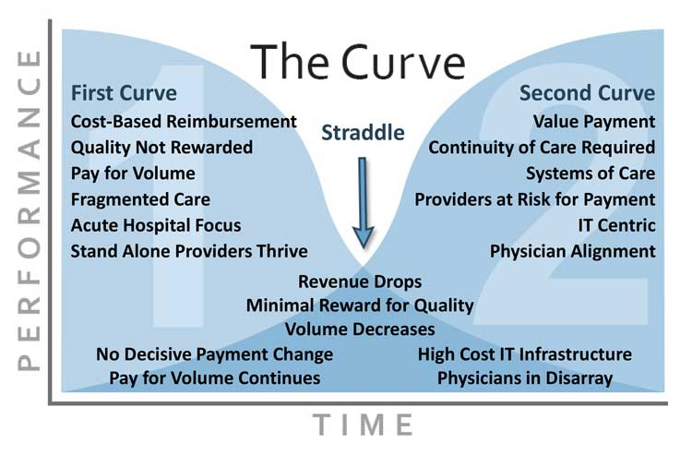
Addressing an era of reform
Population Health
Notes:
Carolyn
LOOKING AT THESE STAGES of Grief AS THEY RELATE TO FINANCIAL PERFORMANCE OVER TIME
AS MEMBERS BEGAN TO “NEGOTIATE” & “ACCEPT” … they became determined to move out of the Straddle and to 2nd Curve
Evolving to 2nd curve reimbursement
Current Initiative:
How are members are utilizing the network to address payment reform?
Reviewing model from Oregon, they were legislated into capitation for Medicaid in 2012
Members are highly engaged, moving forward in analysis phases
A large number of unknowns
ACO vs CCO – overview
Old care model: Sickness System
Health No Disease
Acute Disease
Fee for Service
Hospital Beds Full
Hospital Centric
Doctor Centric
Doctor Decides
Quality Decided by Doc
New Care Model:
Wellness System
Health: Wellness
Chronic Disease
Value Based Payment
Hospital Beds Empty
Community Centric
Patient Centric
Shared Decision Making
Measurable Metrics
We are being responsive to our members, and adhering to their values… (next slide)

Slide 9
What is Population Health?
Population Health
Any medical provider arrangement with a payer in which the provider agrees to provide a defined set of medical services to a defined group of people (the population) and to accomplish 3 critical objectives:
1. Improve the group’s medical outcomes 2. Reduce the group’s per-capita costs 3. Contractually capture a major portion of the savings
population health
Population Health
Notes:
PAT --

Slide 10
What is Population Health?
Population Health
The coordination of care delivery across a population to improve outcomes through disease management, care management, and demand management.
population health
Population Health
Notes:
PAT –
To accomplish this, providers and organizations leverage patient data to analyze morbidity patterns and predict financial risk. Both clinical and financial outcomes are improved by comparing patient data against quality guidelines and identifying care gaps, providers deliver focused patient outreach and care management

Slide 11
Why Rural Has Not Been Involved
Population Health
Limited financial resources and uncertainty about the stability of Medicare Cost-Reimbursement system Lack of knowledge on healthcare reform Lack of experience in population health Leadership Boards and medical staff uncomfortable with change Reactionary and not proactive Not part of strategic plan Lack of significant population size prevents adoptions of risk/reward-based population health solutions
population health
Population Health
Notes:
Pat --
This is what we discovered about Rural providers, in general: List above
CAHs face an even more challenging future than their urban cousins. First, there is growing uncertainty about the stability, and even the continuation of the Medicare cost reimbursement system that has sustained them for years. Second, the lack of significant population size in rural areas prevents providers there from adopting the kinds of risk/reward-based population-health solutions that move the focus away from maximizing utilization volume (ER, IP, OR, OP, imaging, etc.) to maximizing value (i.e., improving quality and reducing pmpm cost).

Slide 12
Networks Have Opportunity to Lead Healthcare Transformation
Population Health
Synergy of pulling groups and individuals – learning from each other/best practices
Developing network tools and programs
Sharing education and training
Sharing costs of research and development and staff time
Providing leadership and communication from a central point

Slide 13
Tell us about YOUR network
Notes:
Pat --
ANY OF THIS SOUND FAMILIAR?? ☺
What about you? (Quick snapshot of audience)
Show of hands:
How many of you offer clinical services?
How many of you offer network programs that produce shared savings and revenue?
How many of you are predominantly hospitals?
How many of you are working with your members, in any fashion, on pop. Health?

Slide 14
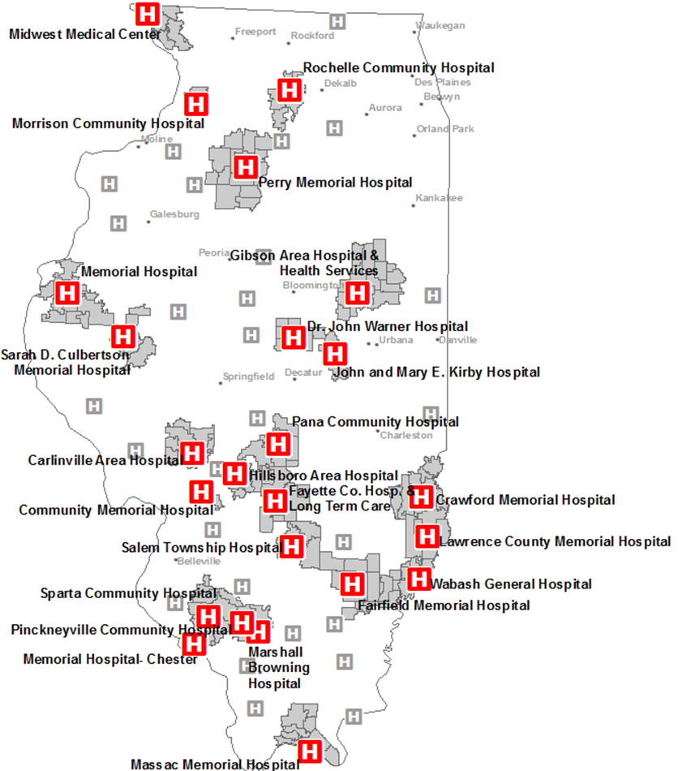
What is Illinois CAH Network?
Season of the network
ICAHN | CCO Statistics
53 members | 24 CAH members
1.2 million residents | 375,000 covered lives
11,000 Employees | 176,000 employer covered lives
$1.9 Gross Patient Revenues | $90,000,000 healthcare dollars ($7,000/person)
37/53 CAHs are independent | CAHs, rural hospitals, physicians – system or independent no restriction
season of the network
Notes:
Pat -- Thank you for sharing…
It is our belief that Health Reform, these Stages of Grief, have led to the SEASON of the NETWORK!
Here’s a little bit about ours

Slide 15
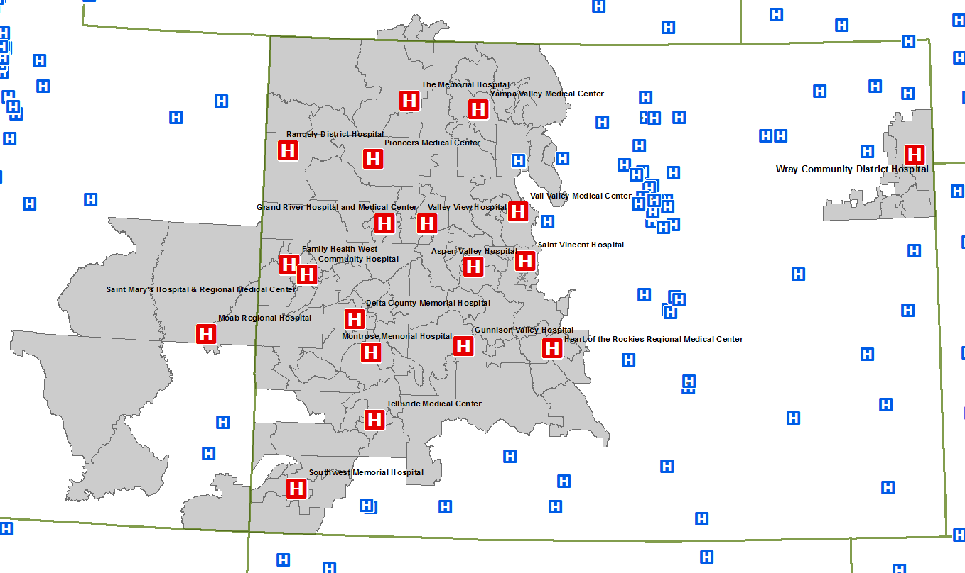
What is Western Healthcare Alliance?
Innovation
WHA | CCO Statistics
27 members 483 affiliated organizations | 21 participating hospitals
81 full-time employees | 498,114 rural residents
$12 million gross revenue | 12,990 hospital employees
52 programs, services & partnerships | $1.1+ billion in net patient revenue
$9 million distributed to member-owners since 2003 ROI 49:1 | 80% member participation
season of the network
Notes:
WHA is dues-based organization with 27 healthcare provider members in Colorado and Utah.
Our organization was founded in 1989 with a charter membership of 12 independent hospitals utilizing their combined volume to obtain services and pricing not typically available to rural hospitals.
Seed money came from capitol contributions by each member and supplemented by a grant from The Colorado Trust to fund a nursing recruitment and retention program.

Slide 16
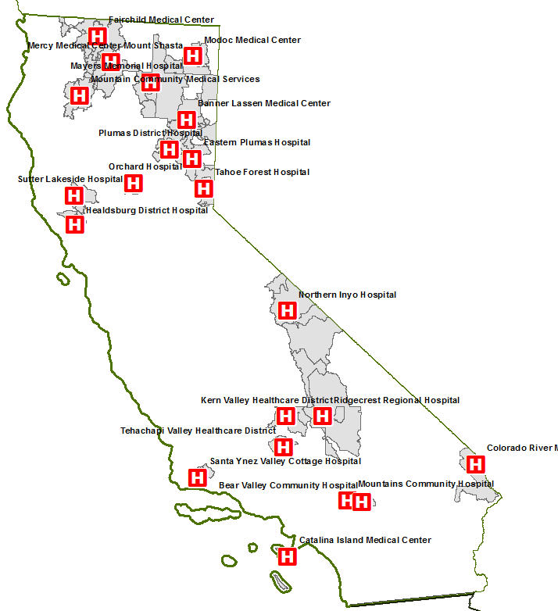
What is California CAH Network?
Innovation
CCAHN | CCO Statistics
36 CAH Members | 22 participating hospitals
2+ full-time employees | 430,118 rural residents
$800,000 gross revenue | 14,229 hospital employees
52 programs, services & partnerships (through N2N) | $790+ million net patient revenue
Affiliated with the California Hospital Association | 70% member participation
season of the network

Slide 17
Season of the Network
season of the network
Notes:
Carolyn
We are IN the “Season of the Network” to support membership moving forward with Population Health Management
Members clearly see the potential to aggregate their population, resources and efforts locally, regionally, network-wide
Workshops, Webinars, Population Health Development Meetings – Very Well Attended!
Administrators are TIRED of waiting for the next [reimbursement] shoe to drop – they like that they are being PROACTIVE!
60% of ICAHN members involved!
65% of CCAHN members involved!
80% of WHA members involved!
Healthcare reform is based on a [rural] model of primary care and community engagement
Large healthcare systems are starting to realize the value of rural networks
Networks have established history and trust with members, giving them credibility
Networks can aggregate patient numbers to create actuarially credible populations
We “get” collaboration, which is going to be crucial for: patient engagement, payer contracting, care coordination, data analytics, HIEs, the list goes on…

Slide 18
Responding to Members’ Values: Custom, Rural Accountable Care Models Believe care is local Primary-care focus Best able to integrate services locally Collectively have leverage in numbers Able to implement new programs quickly Dedicated to independence & viability of rural community → Development of a hybrid type of ACO, owned and governed by its rural members. → Narrow provider network to improve quality, reduce cost AND capture the savings this produces!
Developing Models
developing models
Notes:
Pat – IL, CA, CO Administrators shouted these values Loud and Clear – All 3 networks, all 110 Administrators…
Any Population Health Model had to work with these values
Again, all of these are reasons why it’s the “Season of the Network!” as these are network values, too.
So…What did that lead to? Assessment, research, workshops → hybrid ACO with option to participate in MSSP (ICAHN)
… rural hospitals have the potential to counter threats and limitations by aggregating their individual smaller-population service areas into much larger, more payer-attractive markets that allow them to productively and profitably engage in population-health care models. An added advantage is that such structures can allow participating hospitals to retain their local independence. One mechanism for such market aggregation is a hybrid type of ACO which we call a Community Care Organization (CCO). The function of the CCO—owned and governed by its rural hospital members—is twofold: first, to develop a narrow provider network focused on improving quality, reducing costs, and capturing the savings this produces; and second, to contract with payers desiring access to a substantial and previously inaccessible market for population-health-based benefit plans.

Slide 19
Second Curve Reimbursement Models Illinois Colorado California
Assessment, education, consensus, innovation
developing models
19
Notes:
Pat: high level overview of models examined
Carolyn: ditto for WHA and CCAHN

Slide 20
Networks Collaborating with Networks
Collaborating in rural healthcare delivery
collaboration
20

Slide 21
There’s a lot going on right now!
ICAHN, WHA and CCAHN…
+
+
collaboration
21
Notes:
Between ICAHN, WHA and CCAHN we are representing (50 ICAHN +26 WHA +34 CCAHN) = rural hospitals!
Sharing resources, consultants, methodology across Networks to
Develop member toolkit / resource materials
Present webinars on Patient Centered Medical Home model and other care coordination techniques
Physician engagement strategies
Staff engagement strategies
Innovative reimbursement models

Slide 22
moving forward
Notes:
*Animated slide*
By collaborating across NETWORKS, we are changing the dynamics. By adding the volume, expertise, and collective energy across these three networks, we are able to accomplish more than we’d be able to on our own as networks.
Pat, Carolyn: Summary comments

Slide 23
What is your network working on?
Notes:
Q & A DISCUSSION
What are your networks working with regard to population health?
Does this make sense to you—do you see how it impacts your network?

Slide 24
Thank You
Notes:
Add ICAHN and CCAHN Logo

Slide 25
Contacts
Carolyn Bruce, MBA
Chief Executive Officer
866-683-5203 Carolyn.Bruce@wha1.org
Scot Mitchell, MBA
Senior Vice President
877-683-5227 Scot.Mitchell@wha1.org
Tom Northey, MSM
Director, IT Collaboration
866-986-3657 Tom.Northey@wha1.org
Jessica Taylor, MBA
Vice President, Client Relations
970-250-7670 Jessica.Taylor@wha1.org
Sally Trnka, MBA
Director, Network Development
Executive Director, N2N Strategies
218-310-3070 Sally.Trnka@wha1.org
Pat Schou, MS, FACHE
President, ICAHN
815-875-2999 pschou@icahn.org
Angie Charlet, MHA
Director of Quality and Education
815-875-2999 acharlet@icahn.org
Curt Zimmerman
Director of Business Services and Development
815-875-2999 czimmerman@icahn.org

Slide 26
Appendix
Notes:
Add ICAHN and CCAHN Logo

Slide 27
Established in 2003

Slide 28
WHA &N2N Programs & Corporate Partnerships
Member participation in programs keeps dues stable, eliminates the dependency on grant funding, and allows WHA to develop new programs.
49:1 ROI

Slide 29
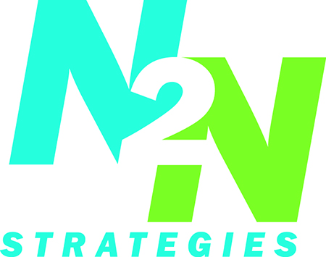
WHA &N2N Programs & Corporate Partnerships

